Slide 1
Cooking with AWS and Splunk
Module 9 : Setting up AWS Kinesis Firehose
Kam Amir | Splunk Cloud Architect

Slide 2
Kinesis Firehose Overview Steps
Prerequisites for Splunk and AWS
Setting up Kinesis Firehose requires configuring AWS to send events into the Firehose.
Splunk requires that you install the Technology Add-on (TA) on the systems with the HEC enabled (e.g. Indexers in a distributed environment).
Create a role with permissions to write to S3, execute Lambda and have access to Kinesis Firehose and streams
Enable HEC with:
A third party signed server SSL Cert. Certificates signed by AWS Certificate Manager will work
Indexer Acknowledgement enabled on the HEC endpoint
Set sourcetype for HEC token, use aws:firehose:json for generic JSON data collection or enter the sourcetype if known (e.g. aws:cloudwatchlogs:vpcflow)
Load Balancer (ELB only) Setup for BYOL Setup

Slide 3
Prerequisites for Splunk and AWS
Make sure to setup Splunk and AWS
Splunk Version 6.6+
Server Signed SSL Certificate (for sending directly to indexer)
Valid HEC URL and Token with indexer acknowledgment enabled
AWS ELB with certificate added to ACM (Amazon Certificate Management)
Splunk TA for Kinesis Firehose installed on Indexers
Non-Splunk Cloud Customers configure inputs.conf with these guidelines: http://docs.splunk.com/Documentation/AddOns/released/Firehose/ConfigureHECdistributed
ackIdleCleanup = true in inputs.conf

Slide 4
Documentation link from AWS
Helpful link for getting KDF data into Splunk
https://docs.aws.amazon.com/firehose/latest/dev/creating-the-stream-to-splunk.html

Slide 5
Kinesis Firehose Architecture Overview

Slide 6




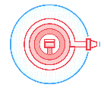



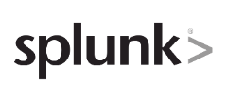

Kinesis Firehose With Splunk Delivery
Native delivery endpoints for Firehose
Ingest
Transform
Deliver
Amazon Kinesis Agent
Amazon S3
Amazon Kinesis Streams
Amazon Redshift
Amazon CloudWatch Logs
Amazon Elasticsearch
Amazon CloudWatch Events
AWS IoT

Slide 7
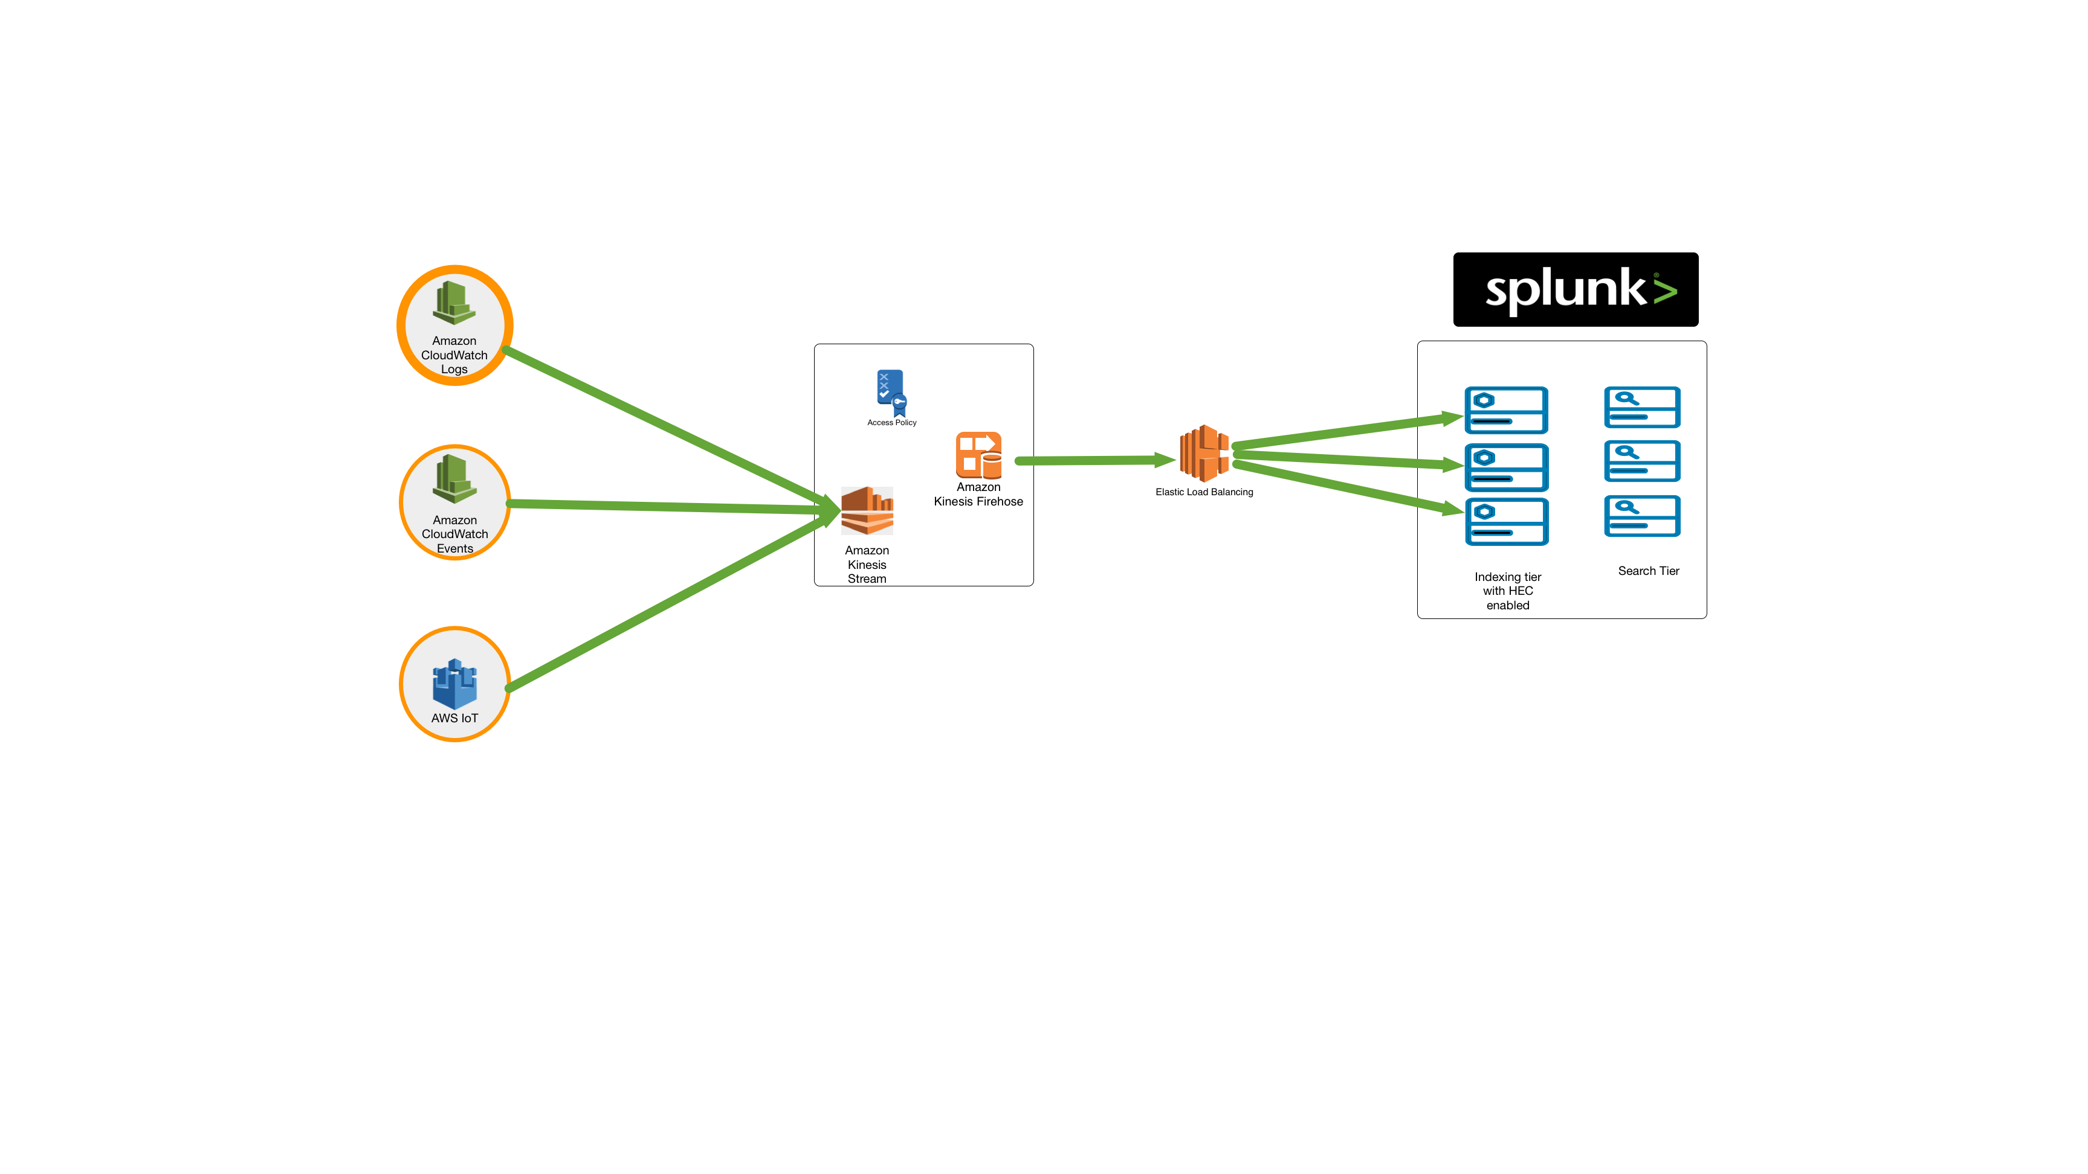
Serverless and Scalable
Supports balancing events to indexing tier directly
Supports Splunk Cloud and Splunk Enterprise
Leverages HTTP Event Collector’s indexer acknowledgement
Makes sure events are written to disk on Splunk’s side
Un-acknowledged events are resent

Slide 8
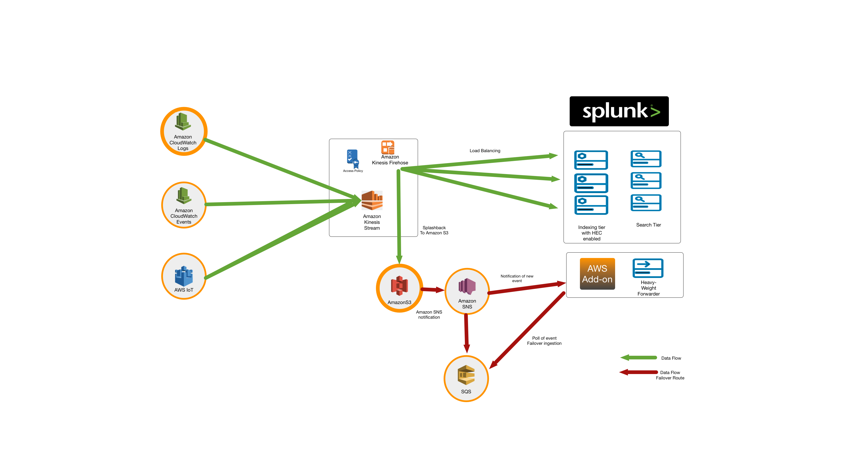
Greater Reliability
Hybrid push / pull
Supports delivery acknowledgment. Un-acknowledged events can be persisted to Amazon S3 and re-ingested via alternative delivery mechanism.
Un-delivered and un-acknowledged events can be ingested from Amazon S3 bucket using poll based mechanism (Splunk add-on for AWS)
Hybrid push/pull: backup route less prone for same bottleneck

Slide 9
CloudWatch Logs to Kinesis Data Firehose

Slide 10
Validate CloudWatch Log Groups
From Module 2 – Configure AWS, make sure CloudWatch Log groups are created for CloudTrail and VPC Flow Logs
Validate AWS CLI is installed and configured with an account that has the ability to create IAM Roles and Policies
(kdf_help) GitHub Link
https://docs.aws.amazon.com/firehose/latest/dev/cw-to-delivery-stream.html

Slide 11
CloudWatch Logs to Kinesis Data Firehose
Create Trust Policy Document
Apply Trust Policy to Account
Create IAM Access Policy for firehose to access IAM Role
Apply Access Policy to Account
Apply Subscription Filter for KDF

Slide 12
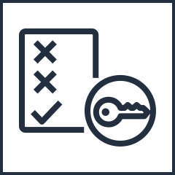
Step 1 – Create IAM Trust Policy
This is a trust IAM Policy that allows sts:Assume role to read cloudwatch logs
The IAM Trust Policy VPCtoSplunkCWtoFHTrustPolicy.json allows the assume the role which has access to the CloudWatch Logs.
Insert the AWS region that has the cloudwatch logs and the KDF
customize
Policy
VPCtoSplunkCWtoFHTrustPolicy.json
{
"Statement": {
"Effect": "Allow",
"Principal": { "Service": "logs.your-region.amazonaws.com" },
"Action": "sts:AssumeRole"
}
}

Slide 13

Step 2 – Create IAM Role
This ‘aws’ command will create a role based on the policy created
When you run the ’aws’ command, it will create the role that has the ability to assume the role and read the CloudWatch Logs.
aws iam put-role-policy --role-name VPCtoSplunkCWtoFHRole --policy-name VPCtoSplunkCWtoFHAccessPolicy --policy-document file://VPCtoSplunkCWtoFHAccessPolicy.json
aws cli
VPCtoSplunkCWtoFHTrustPolicy.json
VPCtoSplunkCWtoFHRole

Slide 14
Step 3 – Create IAM Access Policy
This is a trust IAM Policy that allows Firehose role to Assume the role
The IAM Access Policy VPCtoSplunkCWtoFHAccessPolicy.json allows for Kinesis Firehose (KDF) to assume the role which has access to the CloudWatch Logs.
Insert the AWS region that has the cloudwatch logs and the KDF
customize
Policy
VPCtoSplunkCWtoFHAccessPolicy.json
{ "Statement":[ { "Effect":"Allow", "Action":["firehose:*"], "Resource":["arn:aws:firehose:your-region:your-aws-account-id:deliverystream/VPCtoSplunkStream"] }, { "Effect":"Allow", "Action":["iam:PassRole"], "Resource":["arn:aws:iam::your-aws-account-id:role/VPCtoSplunkCWtoFHRole"] } ] }

Slide 15
Step 4 – Apply Access Role Policy
This ‘aws’ command will create a role based on the policy created
When you run the ’aws’ command, it will create the role that has the ability to assume the role and read the CloudWatch Logs.
Allows KDF access to the CloudWatch Logs
aws iam create-role --role-name VPCtoSplunkCWtoFHRole --assume-role-policy-document file://VPCtoSplunkCWtoFHTrustPolicy.json
aws cli
VPCtoSplunkCWtoFHTrustPolicy.json
VPCtoSplunkCWtoFHRole

Slide 16
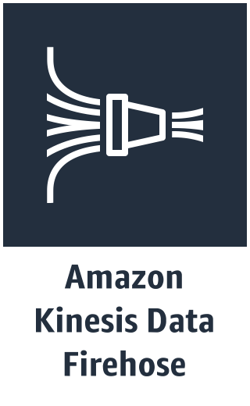


Step 5 – Apply Subscription Filter
This ‘aws’ command will create a subscription filter
This command will create a subscription filter from your CloudWatch Log group to send the data Kinesis Data Firehose (KDF)
aws logs put-subscription-filter --log-group-name "VPCtoSplunkLogGroup" --filter-name "Destination" --filter-pattern "" --destination-arn "arn:aws:firehose:your-region:your-aws-account-id:deliverystream/VPCtoSplunkStream" --role-arn "arn:aws:iam::your-aws-account-id:role/VPCtoSplunkCWtoFHRole"
aws cli
Filtering rule
Flow logs

Slide 17
Process for Kinesis Streams to KDF

Slide 18
Steps for setting up Kinesis
Step 1: Service to Kinesis Stream
Step 2 : Kinesis Stream to Firehose
Step 3 : Setup Splunk HEC

Slide 19
Steps for setting up Kinesis
Step 1 : Service to Kinesis Stream via CloudWatch Logs
Start by sending services to CloudWatch Log Group
Create Subscription filter for Kinesis
Create IAM role (CWLtoKinesisRole) with a trust policy (TrustPolicyforCWL.json) and permissions (PermissionsForCWL.json) that will grant CloudWatch Logs permission to put data into your Kinesis Stream http://docs.aws.amazon.com/AmazonCloudWatch/latest/logs//cwl-ug.pdf#SubscriptionFilters

Slide 20
Steps for setting up Kinesis
Step 2 : Kinesis Stream to Firehose
Create S3 bucket for Kinesis Firehose to write into
Create IAM role (FirehosetoS3Role) with a Trust policy for Kinesis Firehose (TrustPolicyForFirehose.json) to access CloudWatch Logs and permissions (PermissionsForFirehose.json) to write into the S3 bucket
Create destination Kinesis Firehose delivery stream and Splunk HEC endpoint
Grant FirehosetoS3Role Trust relationship to execute Lambda functions

Slide 21
Steps for setting up Kinesis
Step 3 : Setup Splunk HEC
Create HEC Token
Enable Indexer ACK
Select sourcetype
Validate Server Signed SSL Certificate is installed:
On indexers receiving HEC data (OR)
On Elastic Load Balancer (ELB) (OR)
On Heavy Forwarders receiving HEC data
ELB Health Check :8088/services/collector/health/1.0
(Optional) Create HWF with AWS Add-on to collect Kinesis ’splashback’ data from S3 bucket

Slide 22
Setup Load Balancer
For BYOL customers setting up their own collection tier for HEC

Slide 23
Load Balancer Setup
http://docs.splunk.com/Documentation/AddOns/released/Firehose/ConfigureanELB
Make sure to setup your load balancer in AWS with sticky sessions enabled
Load Balancer must be public facing and have a server signed certificate (third party)
HEC Health check URL (https://<site>.splunkcloud.com/services/collector/health/1.0)

Slide 24
Setting up Kinesis Subscription Filters
Create permissions for Kinesis Streams accessing CloudWatch Logs / Events

Slide 25
Kinesis Permissions - CWLtoKinesisRole
http://docs.aws.amazon.com/AmazonCloudWatch/latest/logs/cwl-ug.pdf#SubscriptionFilters
Create destination Kinesis Stream
Run the following command to create a Kinesis Stream called “RootAccess”:
aws kinesis create-stream --stream-name "RootAccess" --shard-count 1
Run this command to see the status: aws kinesis describe-stream --stream-name "RootAccess” and get the ‘StreamARN’
Create CWLtoKinesisRole IAM Role using TrustPolicyForCWL.json (IAM Role Policy) by running this command:
aws iam create-role --role-name CWLtoKinesisRole --assume-role-policy-document file:// ~/TrustPolicyForCWL.json

Slide 26
Kinesis Permissions – FirehosetoS3Role
http://docs.aws.amazon.com/AmazonCloudWatch/latest/logs/cwl-ug.pdf#SubscriptionFilters
Create FirehosetoS3Role IAM Role using PermissionsForFirehose.json (IAM Role Policy) by running this command:
aws iam put-role-policy --role-name FirehosetoS3Role --policy-name Permissions-Policy-For-Firehose --policy-document file://PermissionsForFirehose.json

Slide 27
CloudWatch to Kinesis Stream
This covers CloudWatch Logs, like VPC Flow Logs or logs from the CloudWatch agent, not the metrics from cloudwatch.

Slide 28
Send CloudWatch Logs to Kinesis Stream
http://docs.aws.amazon.com/AmazonCloudWatch/latest/logs/cwl-ug.pdf#SubscriptionFilters
Attach IAM Permissions (PermissionsForCWL.json) to the CWLtoKinesisRole IAM role by running this command:
aws iam put-role-policy --role-name CWLtoKinesisRole --policy-name Permissions-Policy- For-CWL --policy-document file://~/PermissionsForCWL.json
Once the Kinesis Stream is active and you have created all the roles, then run the following command:
aws logs put-subscription-filter \ --log-group-name "CloudTrail" \ --filter-name "RootAccess" \ --filter-pattern "{$.userIdentity.type = Root}" \ --destination-arn "arn:aws:kinesis:us-east-1:123456789012:stream/RootAccess" \ --role-arn "arn:aws:iam::123456789012:role/CWLtoKinesisRole"
Replace 123456789012 with your AWS Account ID

Slide 29
Transform Data using Lambda Function
Some data types coming from CloudWatch Logs, like VPCFlow, require transformation in order to be accepted by Splunk.

Slide 30
Transforming Data from CW Logs with Lambda
This is specific to VPCFlow Logs
Create Lambda function using the Splunk Blue Print ‘kinesis-firehose-cloudwatch-logs-processor’ , name it ’FirehoseVPC’
Enable Trust Relationship for existing role FirehosetoS3Role to execute Lambda functions by running this command:
aws iam update-assume-role-policy --role-name FirehosetoS3Role --policy-document file://LambdaTrustPolicy.json
{
"Statement":
{ "Effect":
"Allow",
"Principal": { "Service": ”lambda.amazonaws.com" },
"Action": "sts:AssumeRole" }
}

Slide 31
Kinesis Stream to Kinesis Firehose
Splunk Destination
http://docs.aws.amazon.com/firehose/latest/dev/writing-with-kinesis-streams.html

Slide 32
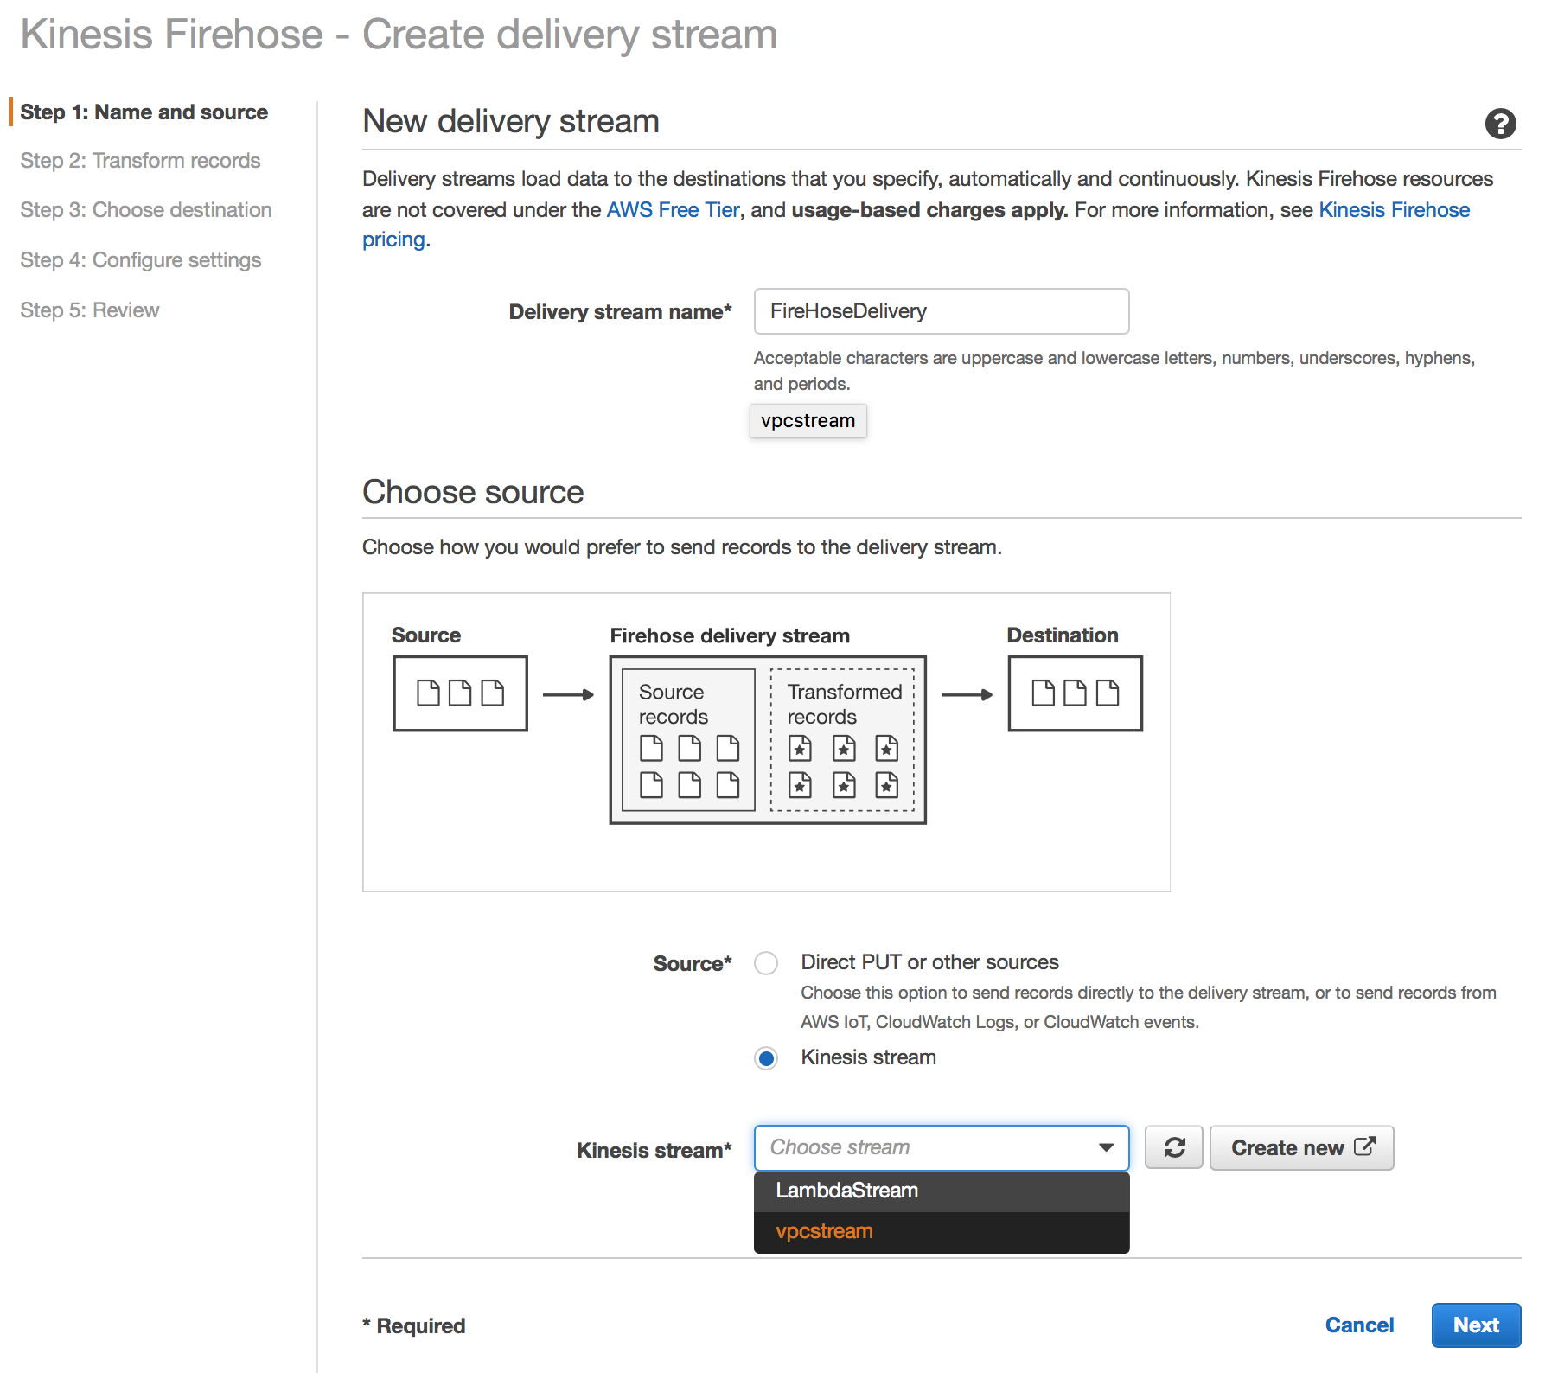
Create Kinesis Firehose Delivery Stream
http://docs.aws.amazon.com/firehose/latest/dev/writing-with-kinesis-streams.html
Create the new Firehose Delivery Stream
Give the Delivery Stream a name (e.g. FireHoseDelivery)
Select the Kinesis Stream Source
Click Next
Notes:
Open the Kinesis Firehose console at https://console.aws.amazon.com/firehose/.
Choose Create Delivery Stream. On the Name and source page, enter values for the following fields:
Delivery stream nameThe name of your Kinesis Firehose delivery stream.
SourceChoose the Kinesis stream option to configure a Kinesis Firehose delivery stream that uses a Kinesis stream as a data source. You can then use Amazon Kinesis Firehose to read data easily from an existing Kinesis stream and load it into destinations.
To use a Kinesis stream as a source, choose an existing stream in the Kinesis stream list, or choose Create new to create a new Kinesis stream. After you create a new stream, chooseRefresh to update the Kinesis stream list. If you have a large number of streams, filter the list using Filter by name.
Note
When you configure a Kinesis stream as the source of a Kinesis Firehose delivery stream, the Kinesis Firehose PutRecord and PutRecordBatch operations are disabled. To add data to your Kinesis Firehose delivery stream in this case, use the Kinesis Streams PutRecord and PutRecords operations.
Kinesis Firehose starts reading data from the LATEST position of your Kinesis stream. For more information about Kinesis Streams positions, see GetShardIterator. Kinesis Firehose calls the Kinesis Streams GetRecords operation once per second for each shard.
More than one Kinesis Firehose delivery stream can read from the same Kinesis stream. Other Kinesis applications (consumers) can also read from the same stream. Each call from any Kinesis Firehose delivery stream or other consumer application counts against the overall throttling limit for the shard. To avoid getting throttled, plan your applications carefully. For more information about Kinesis Streams limits, see Amazon Kinesis Streams Limits.

Slide 33
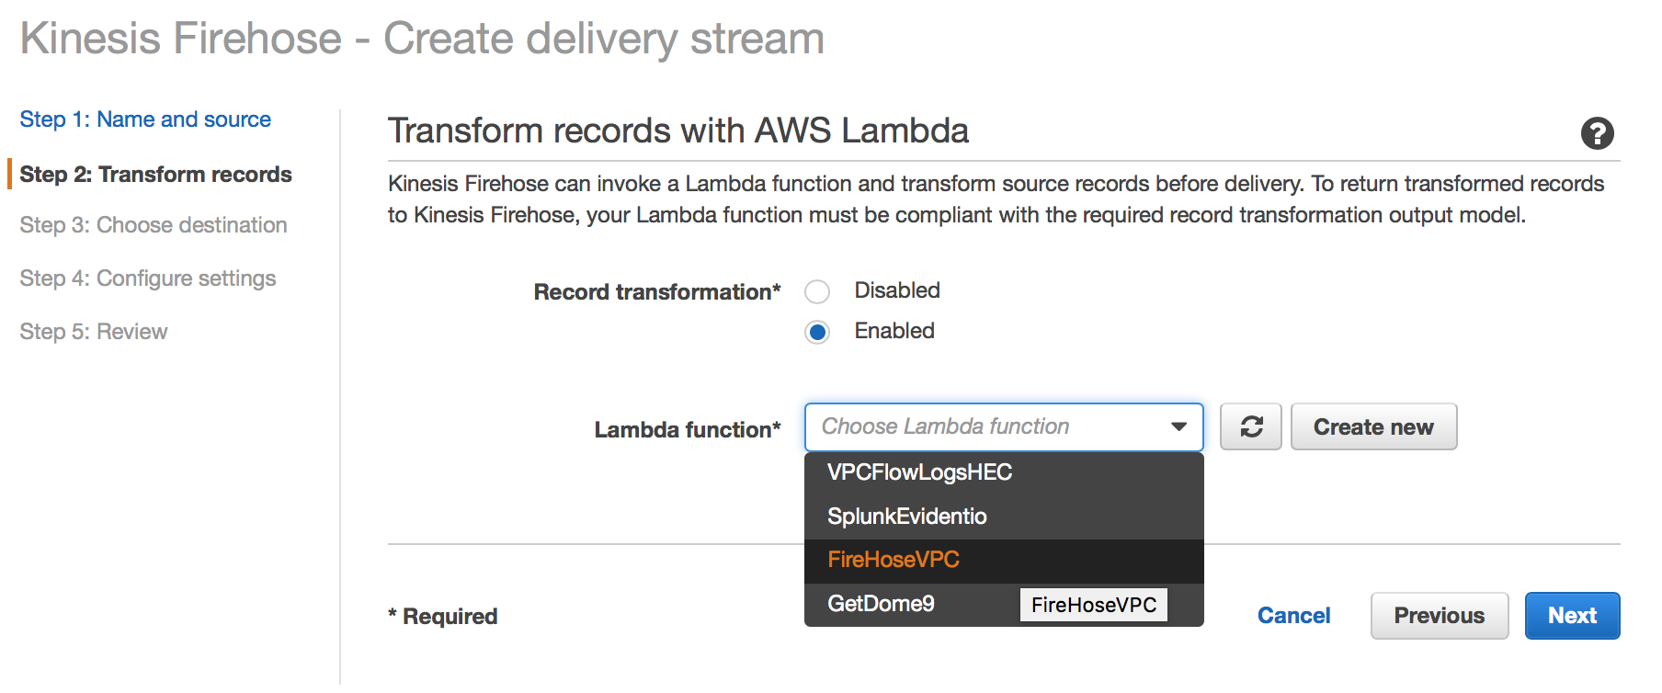
Transform Records with Lambda
Some sources need to be transformed before they are able to be sent to the destination
VPCFlow Logs require a lambda function in order for Splunk to properly index them.
The Lambda Blueprint kinesis-firehose-cloudwatch-logs-processor exists for this purpose. Once created, select the function here.
Notes:
Open the Kinesis Firehose console at https://console.aws.amazon.com/firehose/.
Choose Create Delivery Stream. On the Name and source page, enter values for the following fields:
Delivery stream nameThe name of your Kinesis Firehose delivery stream.
SourceChoose the Kinesis stream option to configure a Kinesis Firehose delivery stream that uses a Kinesis stream as a data source. You can then use Amazon Kinesis Firehose to read data easily from an existing Kinesis stream and load it into destinations.
To use a Kinesis stream as a source, choose an existing stream in the Kinesis stream list, or choose Create new to create a new Kinesis stream. After you create a new stream, chooseRefresh to update the Kinesis stream list. If you have a large number of streams, filter the list using Filter by name.
Note
When you configure a Kinesis stream as the source of a Kinesis Firehose delivery stream, the Kinesis Firehose PutRecord and PutRecordBatch operations are disabled. To add data to your Kinesis Firehose delivery stream in this case, use the Kinesis Streams PutRecord and PutRecords operations.
Kinesis Firehose starts reading data from the LATEST position of your Kinesis stream. For more information about Kinesis Streams positions, see GetShardIterator. Kinesis Firehose calls the Kinesis Streams GetRecords operation once per second for each shard.
More than one Kinesis Firehose delivery stream can read from the same Kinesis stream. Other Kinesis applications (consumers) can also read from the same stream. Each call from any Kinesis Firehose delivery stream or other consumer application counts against the overall throttling limit for the shard. To avoid getting throttled, plan your applications carefully. For more information about Kinesis Streams limits, see Amazon Kinesis Streams Limits.

Slide 34
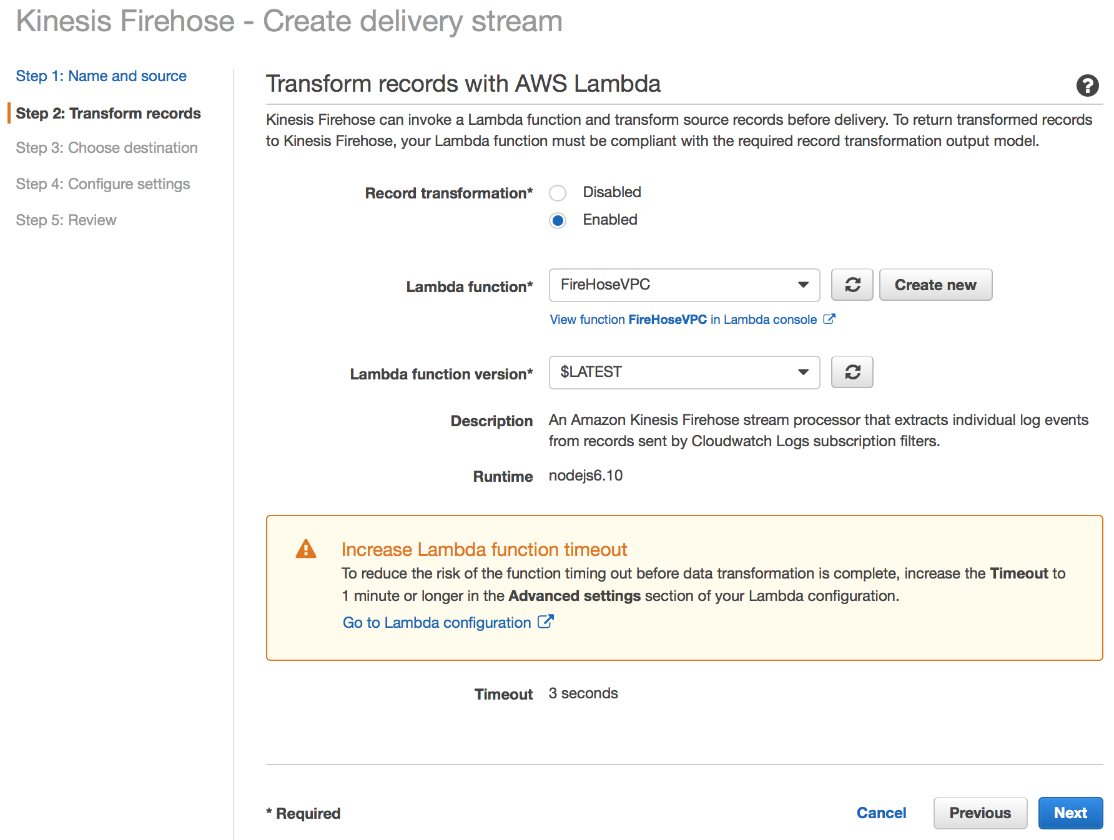
Transform Records with Lambda
Make sure to increase the timeout period from the default 3 seconds to at least 1 minute
Click Next
Notes:
Open the Kinesis Firehose console at https://console.aws.amazon.com/firehose/.
Choose Create Delivery Stream. On the Name and source page, enter values for the following fields:
Delivery stream nameThe name of your Kinesis Firehose delivery stream.
SourceChoose the Kinesis stream option to configure a Kinesis Firehose delivery stream that uses a Kinesis stream as a data source. You can then use Amazon Kinesis Firehose to read data easily from an existing Kinesis stream and load it into destinations.
To use a Kinesis stream as a source, choose an existing stream in the Kinesis stream list, or choose Create new to create a new Kinesis stream. After you create a new stream, chooseRefresh to update the Kinesis stream list. If you have a large number of streams, filter the list using Filter by name.
Note
When you configure a Kinesis stream as the source of a Kinesis Firehose delivery stream, the Kinesis Firehose PutRecord and PutRecordBatch operations are disabled. To add data to your Kinesis Firehose delivery stream in this case, use the Kinesis Streams PutRecord and PutRecords operations.
Kinesis Firehose starts reading data from the LATEST position of your Kinesis stream. For more information about Kinesis Streams positions, see GetShardIterator. Kinesis Firehose calls the Kinesis Streams GetRecords operation once per second for each shard.
More than one Kinesis Firehose delivery stream can read from the same Kinesis stream. Other Kinesis applications (consumers) can also read from the same stream. Each call from any Kinesis Firehose delivery stream or other consumer application counts against the overall throttling limit for the shard. To avoid getting throttled, plan your applications carefully. For more information about Kinesis Streams limits, see Amazon Kinesis Streams Limits.

Slide 35
CloudTrail to CloudWatch Events
Sending API Calls made by CloudTrail to CloudWatch Events

Slide 36
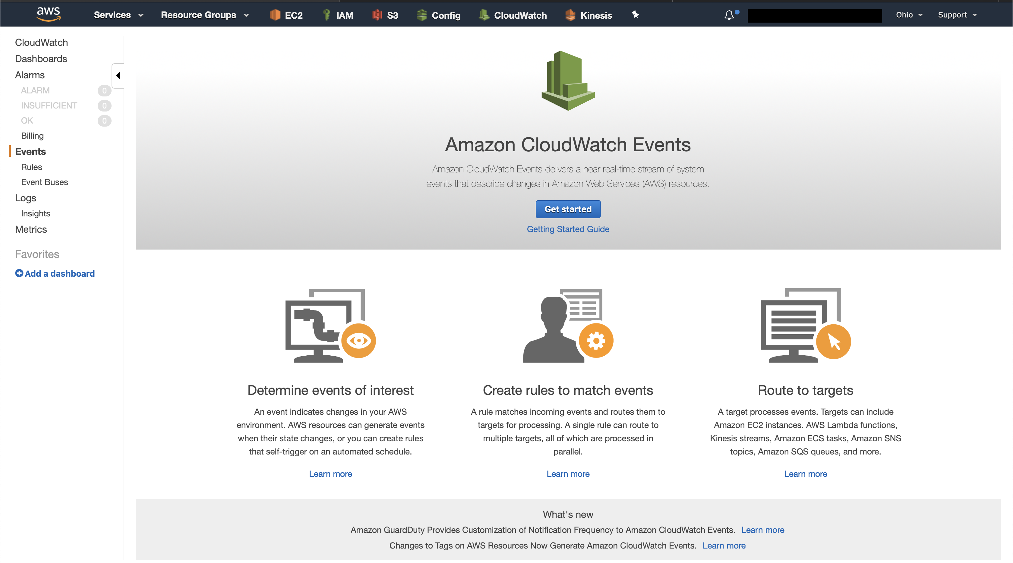
Setup CloudTrail to Send API Calls to CW Events
This is how you get CloudTrail Data into Splunk via Kinesis Firehose
Open CloudWatch and click Get Started
Navigate to the Events along the left-hand side

Slide 37
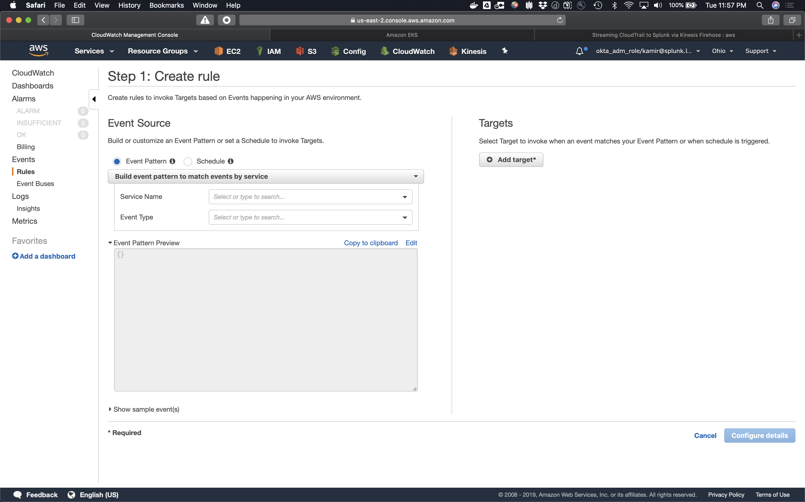
Step 1 : Create rule
Create a new rule to send your CloudTrail API Calls to Splunk via KDF
Create the new rule
Select Event Pattern

Slide 38
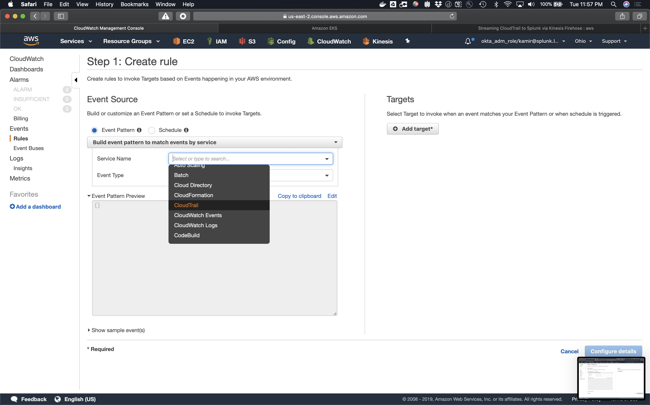
Step 1 : Create rule : Service Name
Select CloudTrail as the Service Name

Slide 39
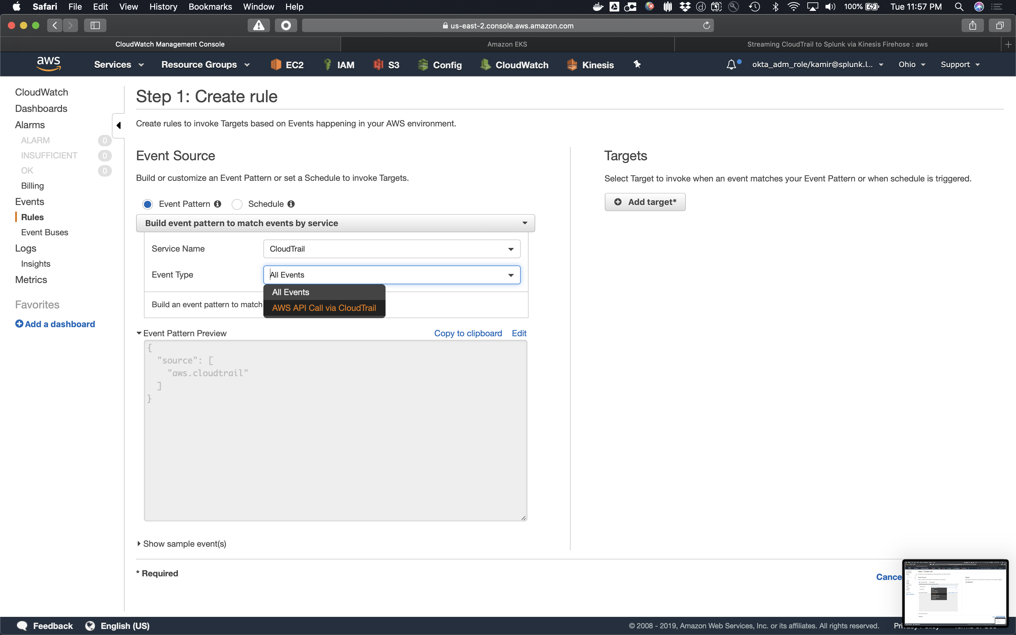
Step 1 : Create rule : Event Type
Select AWS API Call via CloudTrail for the event type
Do NOT select All Events as this will just send you events about CloudTrail and not the API calls within CloudTrail.

Slide 40
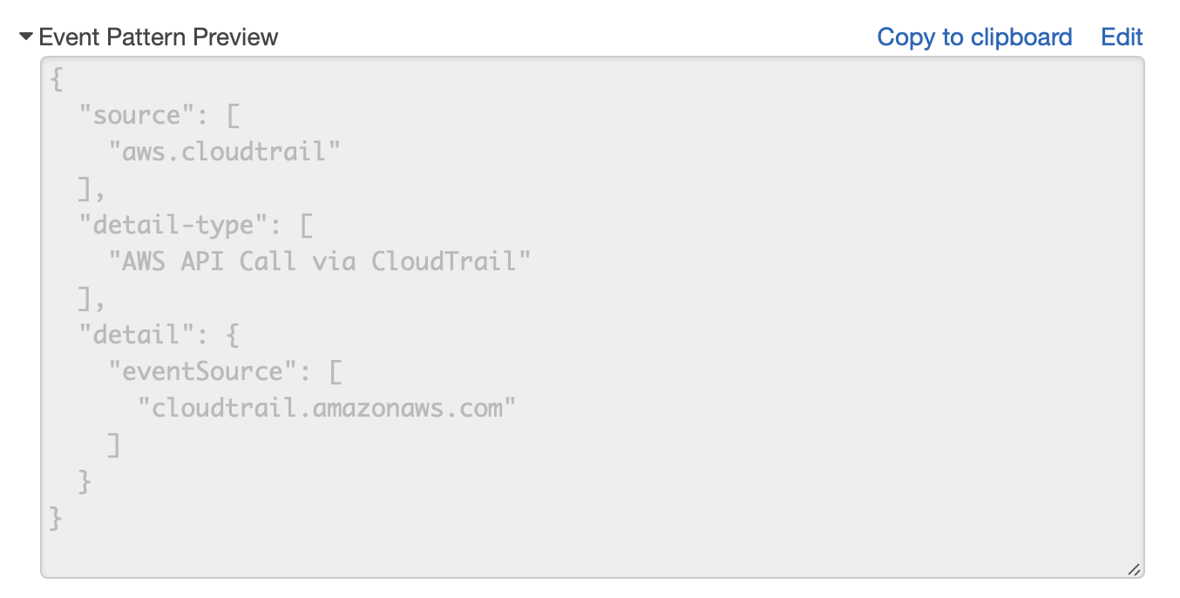
Step 1 : Create rule : Event Pattern Preview
{
"source": [ "aws.cloudtrail"
],
"detail-type": [
"AWS API Call via CloudTrail"
],
"detail": {
"eventSource": [ "cloudtrail.amazonaws.com"
]
}
}

Slide 41
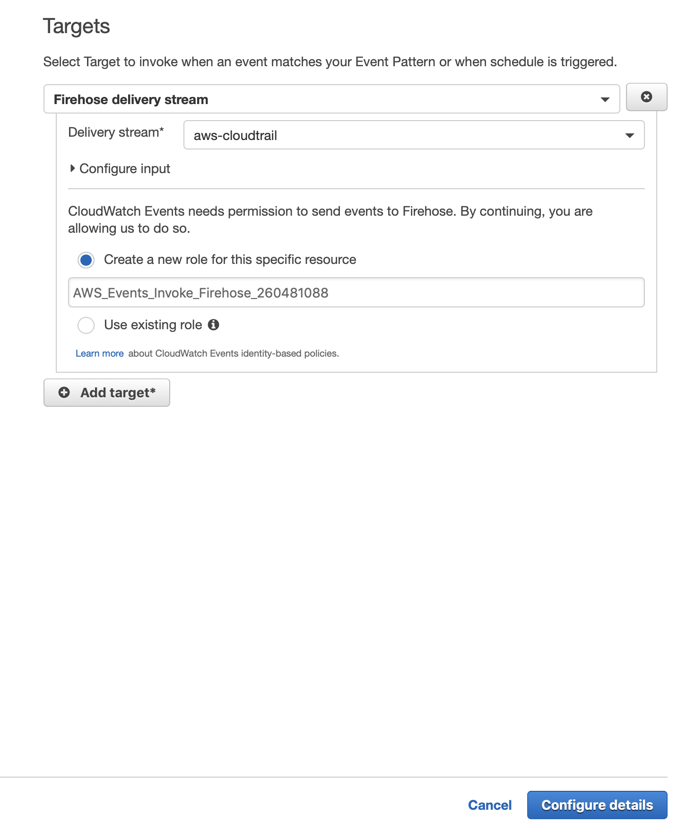
Step 1 : Create rule : Targets
Under Target, select Firehose delivery stream
Create a new role for this specific resource (unless you have an existing role with access to this resource.)
Click Configure details
This is assuming you have created a Firehose delivery stream within the same region.

Slide 42
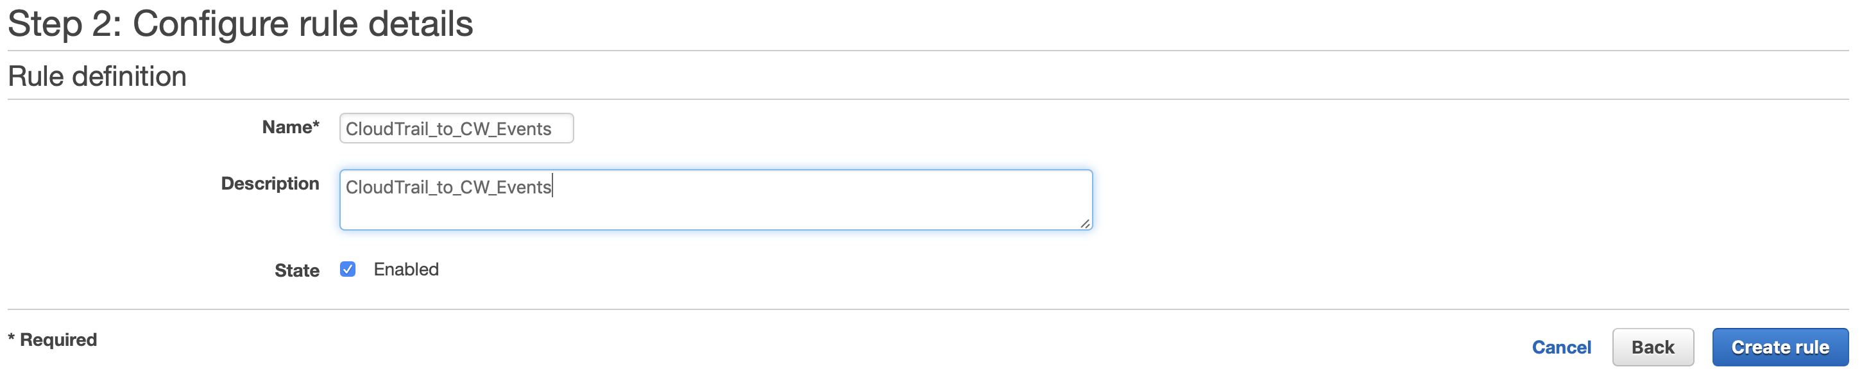
Step 2 : Configure rule details
Give your Rule a name
Optional add a description
Click on Create rule

Slide 43
Kinesis Firehose to Splunk
Send Kinesis Firehose Delivery to Splunk

Slide 44
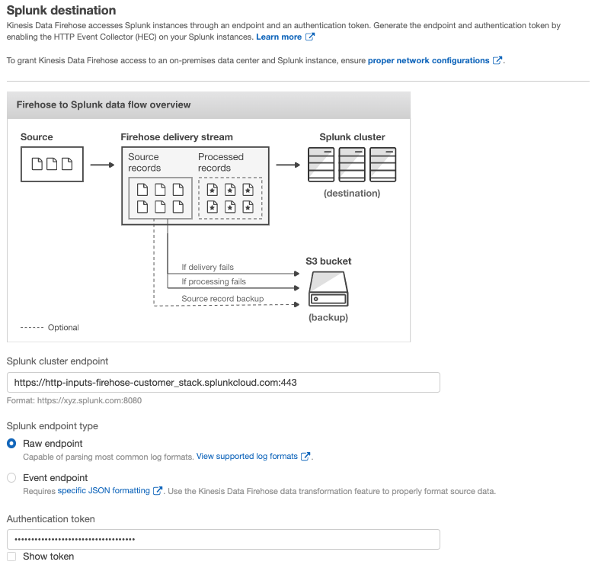
Select a Destination (1/3)
Splunk HEC Destination and Token
Enter the HEC URL and token for your deployment
Refer to this link for details on proper HEC URL: http://docs.splunk.com/Documentation/SplunkCloud/6.6.3/Data/UsetheHTTPEventCollector#Send_data_to_HTTP_Event_Collector
Please note that this can only send to an SSL enabled HEC with Indexer Acknowledgement enabled
Splunk Cloud URL: https://http-inputs-firehose-<stack_id>.splunkcloud.com:443
Where <stack_id> is your customer stack id.
Notes:
Open the Kinesis Firehose console at https://console.aws.amazon.com/firehose/.
Choose Create Delivery Stream. On the Name and source page, enter values for the following fields:
Delivery stream nameThe name of your Kinesis Firehose delivery stream.
SourceChoose the Kinesis stream option to configure a Kinesis Firehose delivery stream that uses a Kinesis stream as a data source. You can then use Amazon Kinesis Firehose to read data easily from an existing Kinesis stream and load it into destinations.
To use a Kinesis stream as a source, choose an existing stream in the Kinesis stream list, or choose Create new to create a new Kinesis stream. After you create a new stream, chooseRefresh to update the Kinesis stream list. If you have a large number of streams, filter the list using Filter by name.
Note
When you configure a Kinesis stream as the source of a Kinesis Firehose delivery stream, the Kinesis Firehose PutRecord and PutRecordBatch operations are disabled. To add data to your Kinesis Firehose delivery stream in this case, use the Kinesis Streams PutRecord and PutRecords operations.
Kinesis Firehose starts reading data from the LATEST position of your Kinesis stream. For more information about Kinesis Streams positions, see GetShardIterator. Kinesis Firehose calls the Kinesis Streams GetRecords operation once per second for each shard.
More than one Kinesis Firehose delivery stream can read from the same Kinesis stream. Other Kinesis applications (consumers) can also read from the same stream. Each call from any Kinesis Firehose delivery stream or other consumer application counts against the overall throttling limit for the shard. To avoid getting throttled, plan your applications carefully. For more information about Kinesis Streams limits, see Amazon Kinesis Streams Limits.

Slide 45
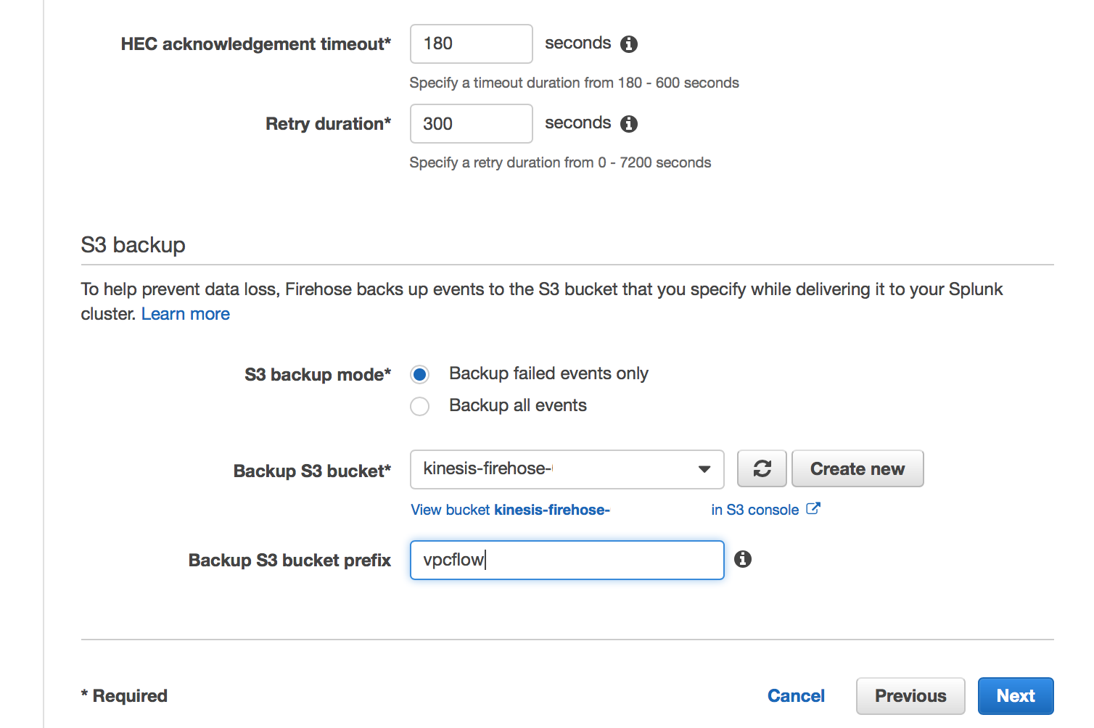
Select a Destination (2/3)
HEC and S3 Setup
Leave the HEC time out and retry as default
Send failed events to S3 backup
Add Prefix (e.g. vpcflow) if you are sending multiple failures to the same S3 bucket
Click Next
Notes:
Open the Kinesis Firehose console at https://console.aws.amazon.com/firehose/.
Choose Create Delivery Stream. On the Name and source page, enter values for the following fields:
Delivery stream nameThe name of your Kinesis Firehose delivery stream.
SourceChoose the Kinesis stream option to configure a Kinesis Firehose delivery stream that uses a Kinesis stream as a data source. You can then use Amazon Kinesis Firehose to read data easily from an existing Kinesis stream and load it into destinations.
To use a Kinesis stream as a source, choose an existing stream in the Kinesis stream list, or choose Create new to create a new Kinesis stream. After you create a new stream, chooseRefresh to update the Kinesis stream list. If you have a large number of streams, filter the list using Filter by name.
Note
When you configure a Kinesis stream as the source of a Kinesis Firehose delivery stream, the Kinesis Firehose PutRecord and PutRecordBatch operations are disabled. To add data to your Kinesis Firehose delivery stream in this case, use the Kinesis Streams PutRecord and PutRecords operations.
Kinesis Firehose starts reading data from the LATEST position of your Kinesis stream. For more information about Kinesis Streams positions, see GetShardIterator. Kinesis Firehose calls the Kinesis Streams GetRecords operation once per second for each shard.
More than one Kinesis Firehose delivery stream can read from the same Kinesis stream. Other Kinesis applications (consumers) can also read from the same stream. Each call from any Kinesis Firehose delivery stream or other consumer application counts against the overall throttling limit for the shard. To avoid getting throttled, plan your applications carefully. For more information about Kinesis Streams limits, see Amazon Kinesis Streams Limits.

Slide 46
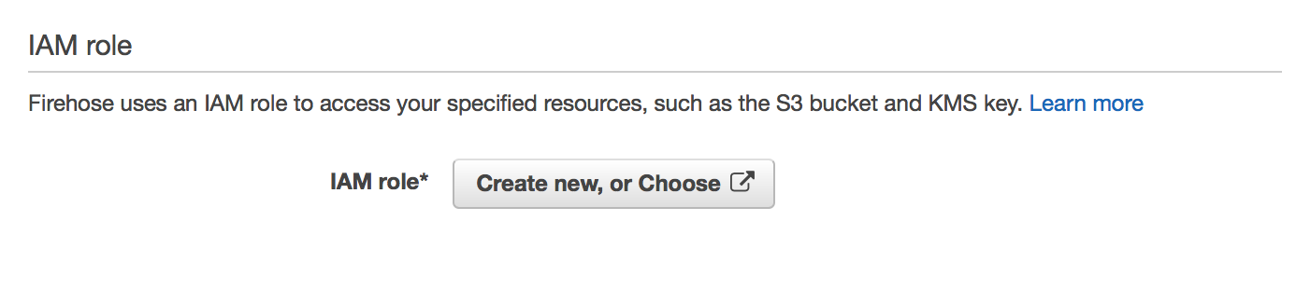
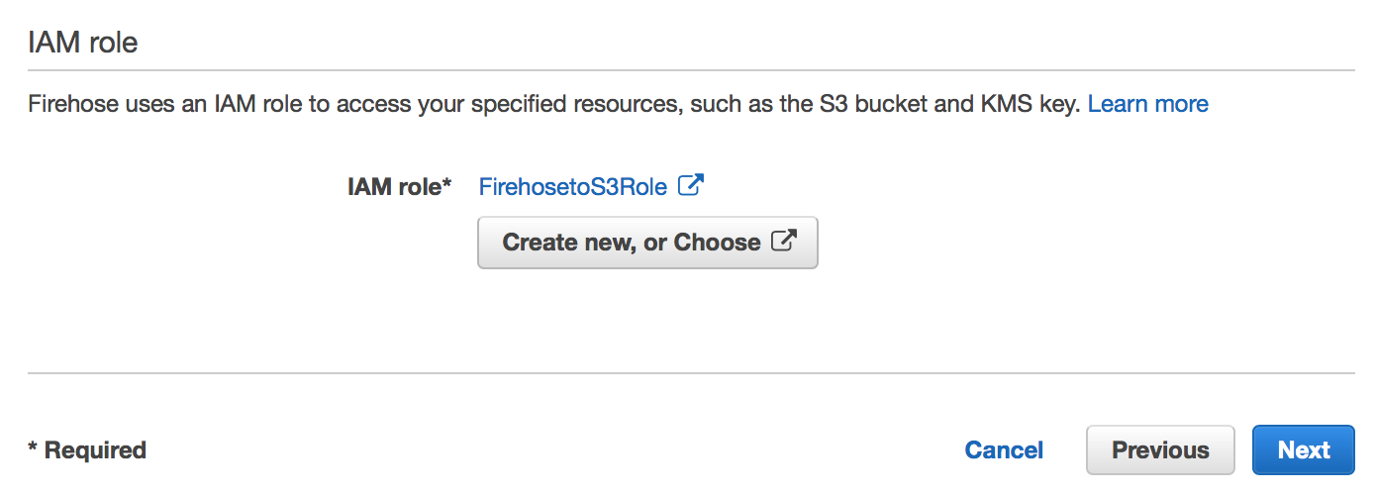
Select a Destination (3/3)
IAM Role
If you are using the default role created for Firehose (FirehosetoS3Role), then make sure to grant it access to execute Lambda Functions and access to the S3 bucket
Click Next
Add / Update Policy for FirehosetoS3Role
Notes:
Open the Kinesis Firehose console at https://console.aws.amazon.com/firehose/.
Choose Create Delivery Stream. On the Name and source page, enter values for the following fields:
Delivery stream nameThe name of your Kinesis Firehose delivery stream.
SourceChoose the Kinesis stream option to configure a Kinesis Firehose delivery stream that uses a Kinesis stream as a data source. You can then use Amazon Kinesis Firehose to read data easily from an existing Kinesis stream and load it into destinations.
To use a Kinesis stream as a source, choose an existing stream in the Kinesis stream list, or choose Create new to create a new Kinesis stream. After you create a new stream, chooseRefresh to update the Kinesis stream list. If you have a large number of streams, filter the list using Filter by name.
Note
When you configure a Kinesis stream as the source of a Kinesis Firehose delivery stream, the Kinesis Firehose PutRecord and PutRecordBatch operations are disabled. To add data to your Kinesis Firehose delivery stream in this case, use the Kinesis Streams PutRecord and PutRecords operations.
Kinesis Firehose starts reading data from the LATEST position of your Kinesis stream. For more information about Kinesis Streams positions, see GetShardIterator. Kinesis Firehose calls the Kinesis Streams GetRecords operation once per second for each shard.
More than one Kinesis Firehose delivery stream can read from the same Kinesis stream. Other Kinesis applications (consumers) can also read from the same stream. Each call from any Kinesis Firehose delivery stream or other consumer application counts against the overall throttling limit for the shard. To avoid getting throttled, plan your applications carefully. For more information about Kinesis Streams limits, see Amazon Kinesis Streams Limits.

Slide 47
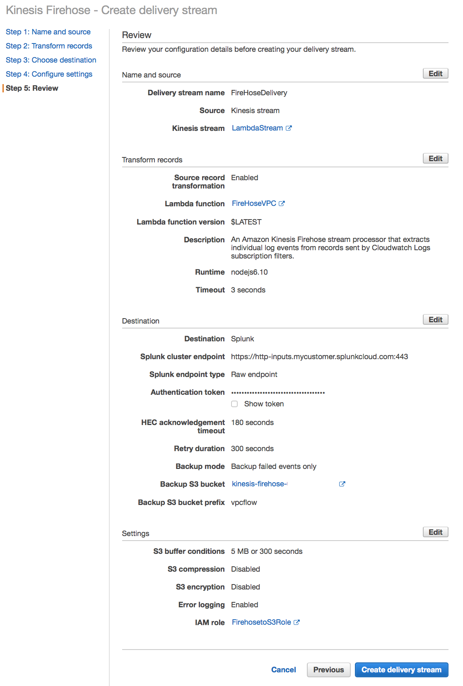
Review
Review the Delivery Stream settings
Once created, the settings can be edited through the Kinesis Firehose console screen
Click Create delivery stream
Notes:
Open the Kinesis Firehose console at https://console.aws.amazon.com/firehose/.
Choose Create Delivery Stream. On the Name and source page, enter values for the following fields:
Delivery stream nameThe name of your Kinesis Firehose delivery stream.
SourceChoose the Kinesis stream option to configure a Kinesis Firehose delivery stream that uses a Kinesis stream as a data source. You can then use Amazon Kinesis Firehose to read data easily from an existing Kinesis stream and load it into destinations.
To use a Kinesis stream as a source, choose an existing stream in the Kinesis stream list, or choose Create new to create a new Kinesis stream. After you create a new stream, chooseRefresh to update the Kinesis stream list. If you have a large number of streams, filter the list using Filter by name.
Note
When you configure a Kinesis stream as the source of a Kinesis Firehose delivery stream, the Kinesis Firehose PutRecord and PutRecordBatch operations are disabled. To add data to your Kinesis Firehose delivery stream in this case, use the Kinesis Streams PutRecord and PutRecords operations.
Kinesis Firehose starts reading data from the LATEST position of your Kinesis stream. For more information about Kinesis Streams positions, see GetShardIterator. Kinesis Firehose calls the Kinesis Streams GetRecords operation once per second for each shard.
More than one Kinesis Firehose delivery stream can read from the same Kinesis stream. Other Kinesis applications (consumers) can also read from the same stream. Each call from any Kinesis Firehose delivery stream or other consumer application counts against the overall throttling limit for the shard. To avoid getting throttled, plan your applications carefully. For more information about Kinesis Streams limits, see Amazon Kinesis Streams Limits.

Slide 48
Test Kinesis Firehose to Splunk
Testing Splunk HEC is able to collect data from Firehose

Slide 49
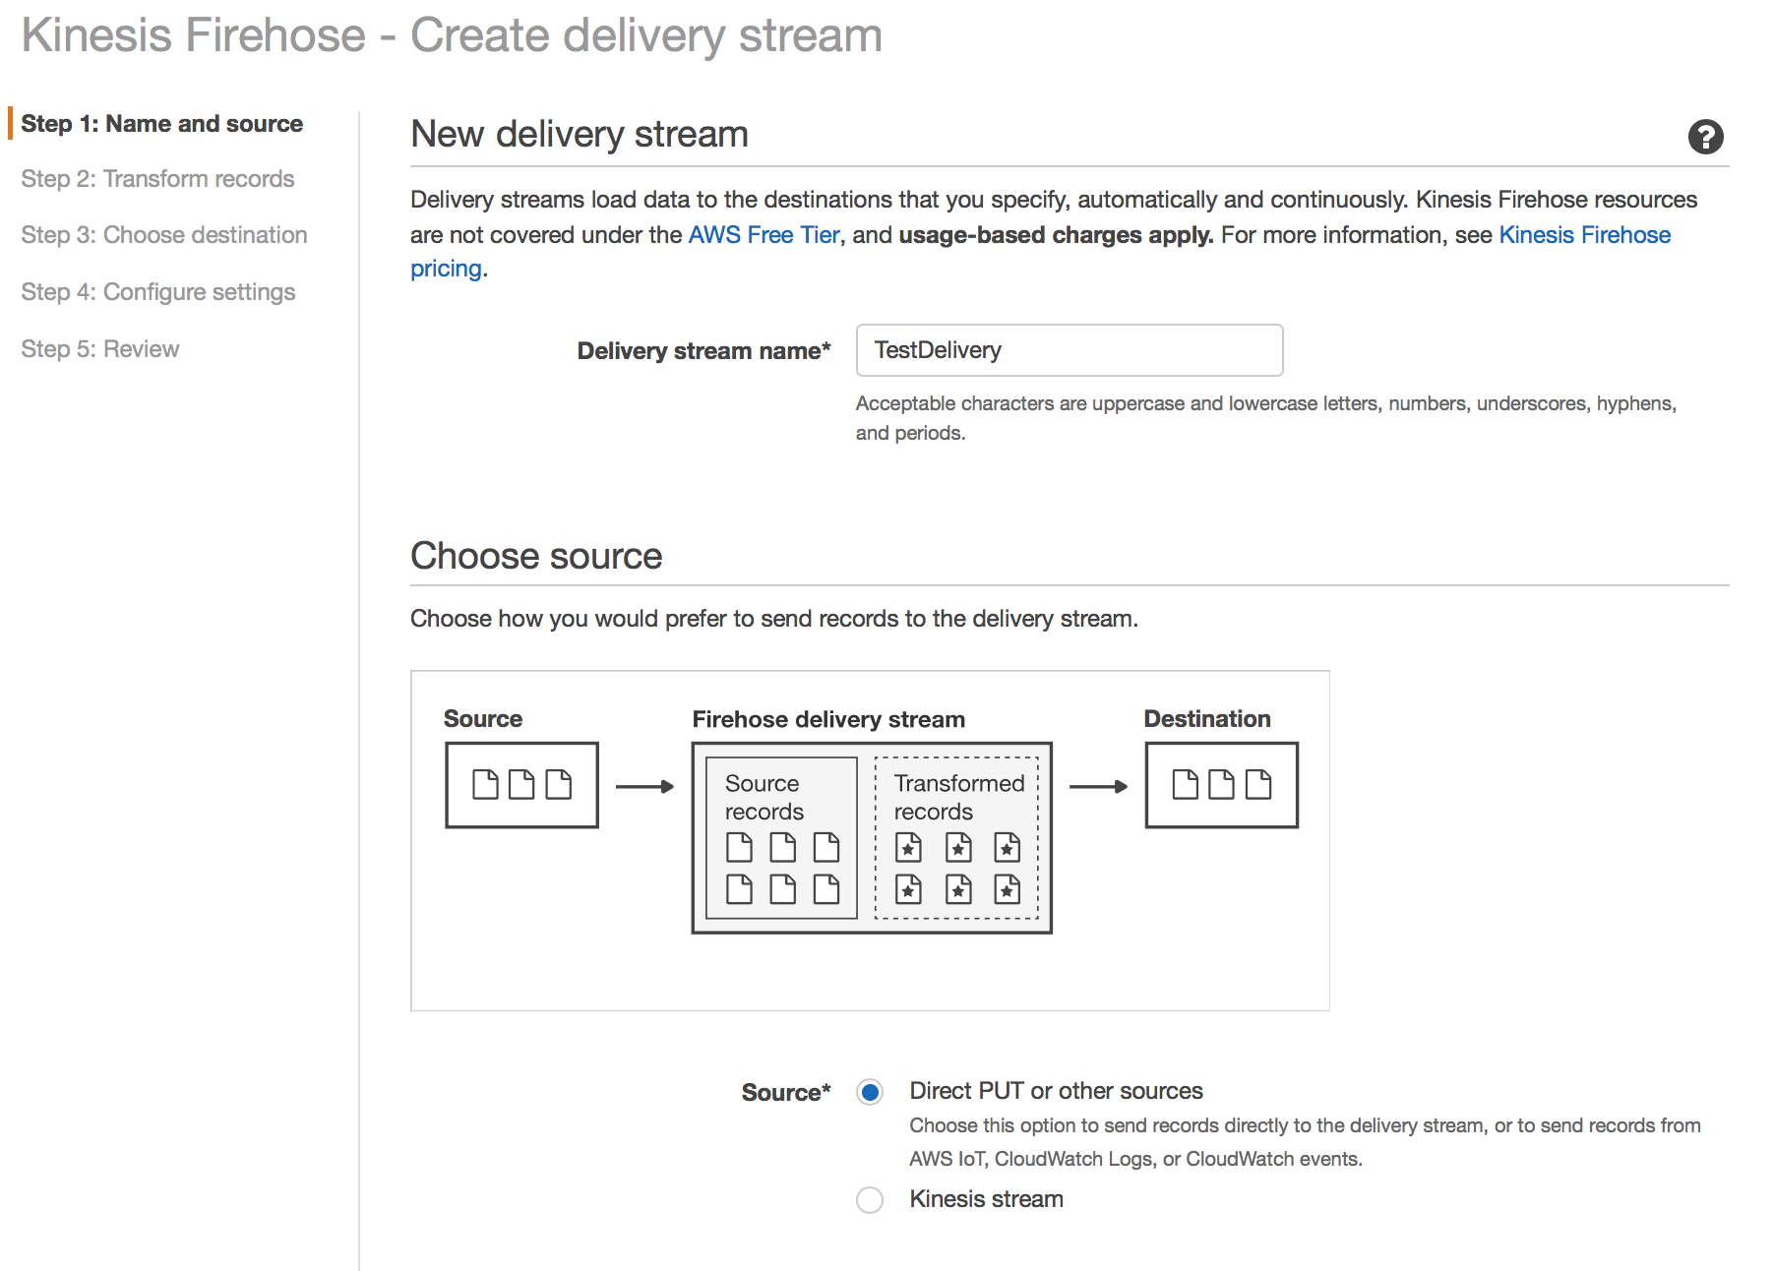
Create Test Kinesis Firehose Delivery
http://docs.aws.amazon.com/firehose/latest/dev/writing-with-kinesis-streams.html
Create the new Firehose Delivery Stream
Give the Delivery Stream a name (e.g. TestDelivery)
Select Direct PUT or other sources
Click Next
Notes:
Open the Kinesis Firehose console at https://console.aws.amazon.com/firehose/.
Choose Create Delivery Stream. On the Name and source page, enter values for the following fields:
Delivery stream nameThe name of your Kinesis Firehose delivery stream.
SourceChoose the Kinesis stream option to configure a Kinesis Firehose delivery stream that uses a Kinesis stream as a data source. You can then use Amazon Kinesis Firehose to read data easily from an existing Kinesis stream and load it into destinations.
To use a Kinesis stream as a source, choose an existing stream in the Kinesis stream list, or choose Create new to create a new Kinesis stream. After you create a new stream, chooseRefresh to update the Kinesis stream list. If you have a large number of streams, filter the list using Filter by name.
Note
When you configure a Kinesis stream as the source of a Kinesis Firehose delivery stream, the Kinesis Firehose PutRecord and PutRecordBatch operations are disabled. To add data to your Kinesis Firehose delivery stream in this case, use the Kinesis Streams PutRecord and PutRecords operations.
Kinesis Firehose starts reading data from the LATEST position of your Kinesis stream. For more information about Kinesis Streams positions, see GetShardIterator. Kinesis Firehose calls the Kinesis Streams GetRecords operation once per second for each shard.
More than one Kinesis Firehose delivery stream can read from the same Kinesis stream. Other Kinesis applications (consumers) can also read from the same stream. Each call from any Kinesis Firehose delivery stream or other consumer application counts against the overall throttling limit for the shard. To avoid getting throttled, plan your applications carefully. For more information about Kinesis Streams limits, see Amazon Kinesis Streams Limits.

Slide 50
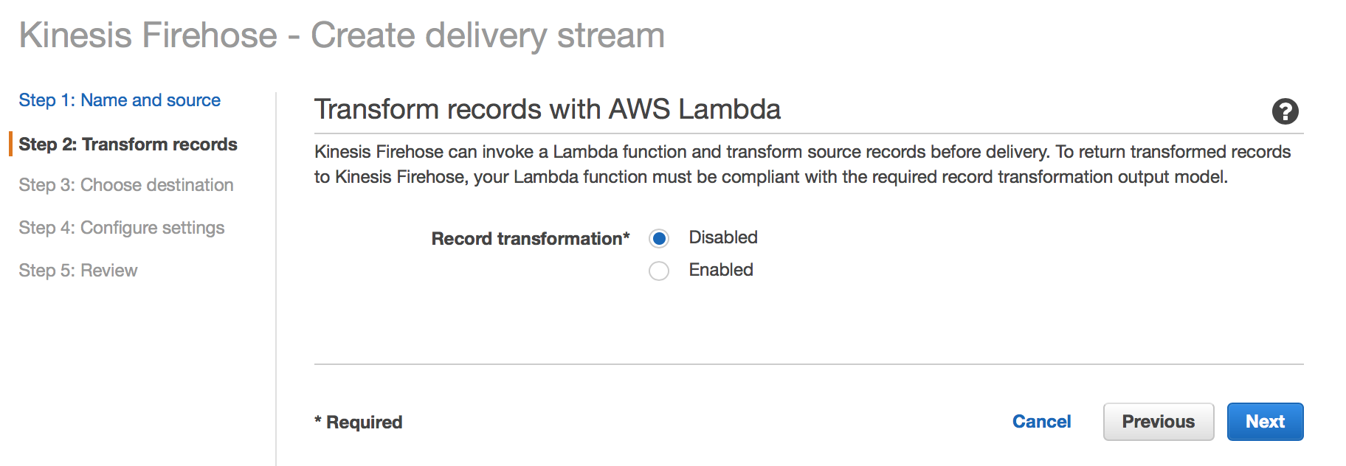
Record Transformation
http://docs.aws.amazon.com/firehose/latest/dev/writing-with-kinesis-streams.html
Keep record transformation DISABLED
Click Next
Notes:
Open the Kinesis Firehose console at https://console.aws.amazon.com/firehose/.
Choose Create Delivery Stream. On the Name and source page, enter values for the following fields:
Delivery stream nameThe name of your Kinesis Firehose delivery stream.
SourceChoose the Kinesis stream option to configure a Kinesis Firehose delivery stream that uses a Kinesis stream as a data source. You can then use Amazon Kinesis Firehose to read data easily from an existing Kinesis stream and load it into destinations.
To use a Kinesis stream as a source, choose an existing stream in the Kinesis stream list, or choose Create new to create a new Kinesis stream. After you create a new stream, chooseRefresh to update the Kinesis stream list. If you have a large number of streams, filter the list using Filter by name.
Note
When you configure a Kinesis stream as the source of a Kinesis Firehose delivery stream, the Kinesis Firehose PutRecord and PutRecordBatch operations are disabled. To add data to your Kinesis Firehose delivery stream in this case, use the Kinesis Streams PutRecord and PutRecords operations.
Kinesis Firehose starts reading data from the LATEST position of your Kinesis stream. For more information about Kinesis Streams positions, see GetShardIterator. Kinesis Firehose calls the Kinesis Streams GetRecords operation once per second for each shard.
More than one Kinesis Firehose delivery stream can read from the same Kinesis stream. Other Kinesis applications (consumers) can also read from the same stream. Each call from any Kinesis Firehose delivery stream or other consumer application counts against the overall throttling limit for the shard. To avoid getting throttled, plan your applications carefully. For more information about Kinesis Streams limits, see Amazon Kinesis Streams Limits.

Slide 51
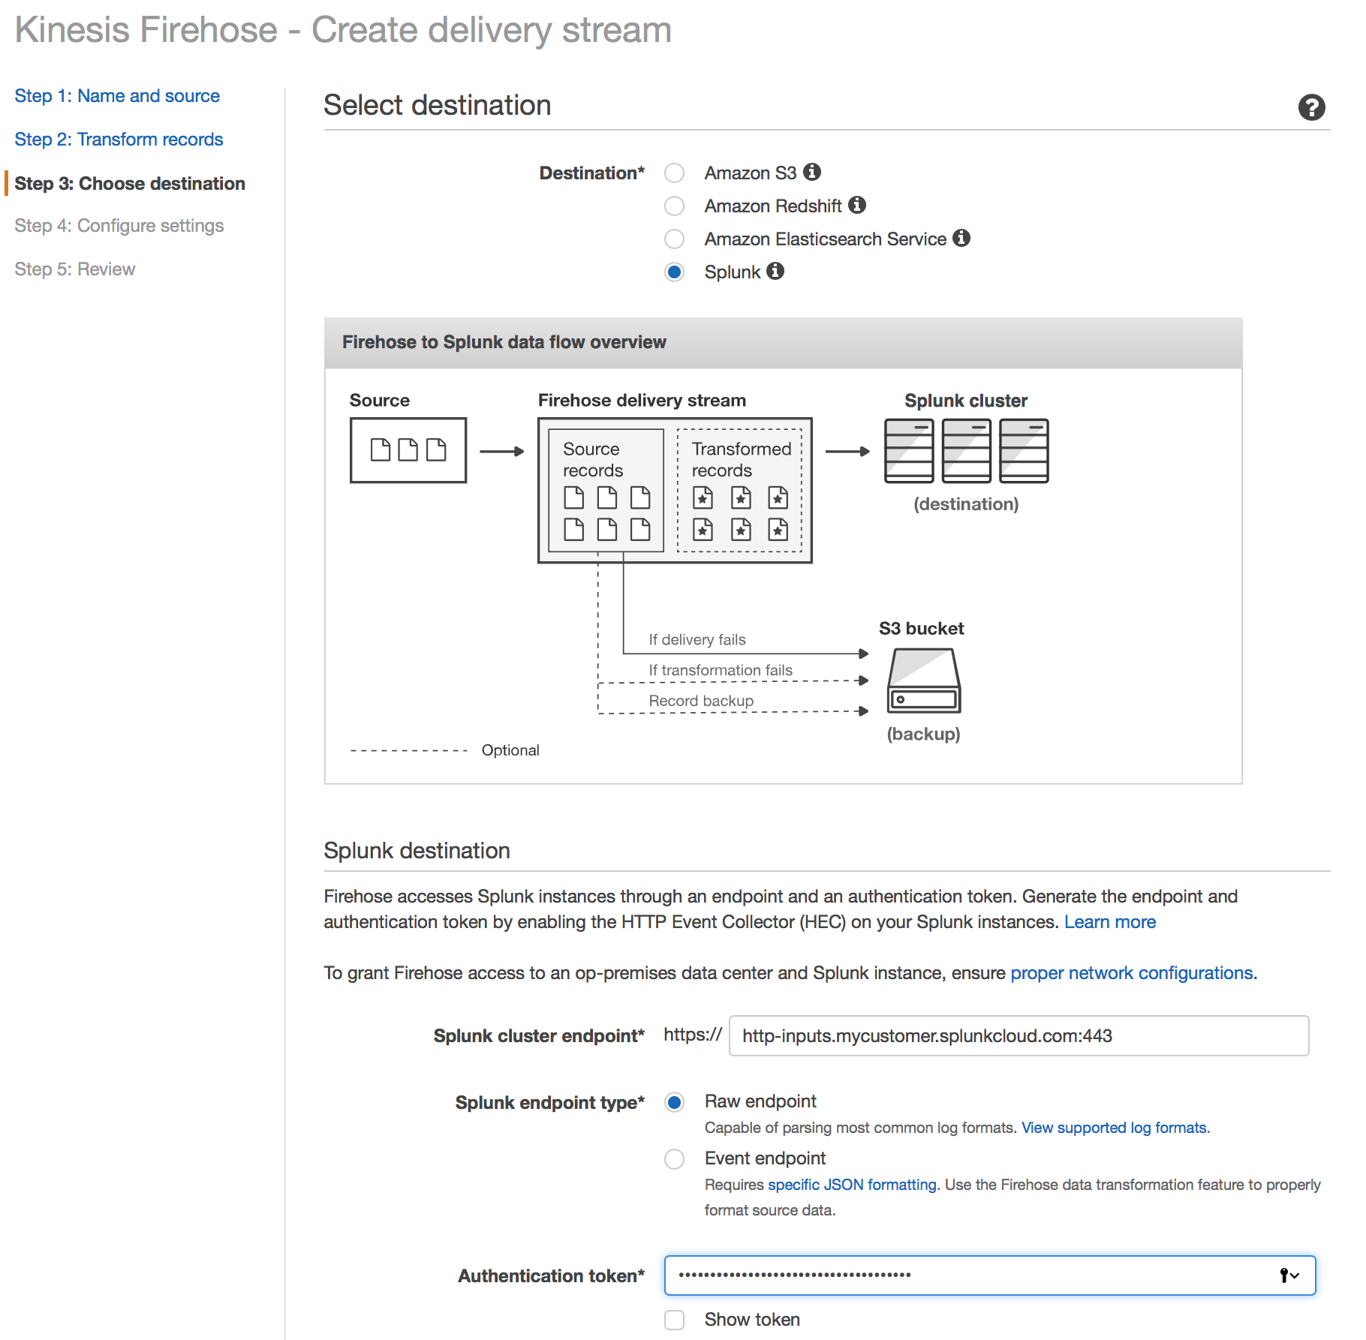
Select a Destination (1/3)
Splunk HEC Destination and Token
Select Splunk as the Destination for this Kinesis Firehose
Enter the HEC URL and token for your deployment
Please note that this can only send to a SSL enabled HEC with Indexer Acknowledgement enabled
Notes:
Open the Kinesis Firehose console at https://console.aws.amazon.com/firehose/.
Choose Create Delivery Stream. On the Name and source page, enter values for the following fields:
Delivery stream nameThe name of your Kinesis Firehose delivery stream.
SourceChoose the Kinesis stream option to configure a Kinesis Firehose delivery stream that uses a Kinesis stream as a data source. You can then use Amazon Kinesis Firehose to read data easily from an existing Kinesis stream and load it into destinations.
To use a Kinesis stream as a source, choose an existing stream in the Kinesis stream list, or choose Create new to create a new Kinesis stream. After you create a new stream, chooseRefresh to update the Kinesis stream list. If you have a large number of streams, filter the list using Filter by name.
Note
When you configure a Kinesis stream as the source of a Kinesis Firehose delivery stream, the Kinesis Firehose PutRecord and PutRecordBatch operations are disabled. To add data to your Kinesis Firehose delivery stream in this case, use the Kinesis Streams PutRecord and PutRecords operations.
Kinesis Firehose starts reading data from the LATEST position of your Kinesis stream. For more information about Kinesis Streams positions, see GetShardIterator. Kinesis Firehose calls the Kinesis Streams GetRecords operation once per second for each shard.
More than one Kinesis Firehose delivery stream can read from the same Kinesis stream. Other Kinesis applications (consumers) can also read from the same stream. Each call from any Kinesis Firehose delivery stream or other consumer application counts against the overall throttling limit for the shard. To avoid getting throttled, plan your applications carefully. For more information about Kinesis Streams limits, see Amazon Kinesis Streams Limits.

Slide 52
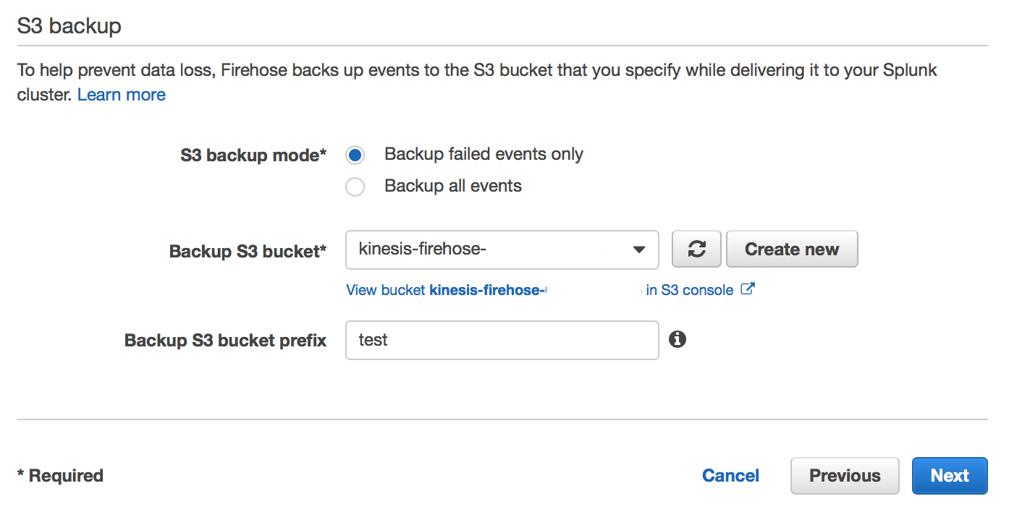
Select a Destination (2/3)
HEC and S3 Setup
Leave the HEC time out and retry as default
Send failed events to S3 backup
Add Prefix (e.g. test) if you are sending multiple failures to the same S3 bucket
Click Next
Notes:
Open the Kinesis Firehose console at https://console.aws.amazon.com/firehose/.
Choose Create Delivery Stream. On the Name and source page, enter values for the following fields:
Delivery stream nameThe name of your Kinesis Firehose delivery stream.
SourceChoose the Kinesis stream option to configure a Kinesis Firehose delivery stream that uses a Kinesis stream as a data source. You can then use Amazon Kinesis Firehose to read data easily from an existing Kinesis stream and load it into destinations.
To use a Kinesis stream as a source, choose an existing stream in the Kinesis stream list, or choose Create new to create a new Kinesis stream. After you create a new stream, chooseRefresh to update the Kinesis stream list. If you have a large number of streams, filter the list using Filter by name.
Note
When you configure a Kinesis stream as the source of a Kinesis Firehose delivery stream, the Kinesis Firehose PutRecord and PutRecordBatch operations are disabled. To add data to your Kinesis Firehose delivery stream in this case, use the Kinesis Streams PutRecord and PutRecords operations.
Kinesis Firehose starts reading data from the LATEST position of your Kinesis stream. For more information about Kinesis Streams positions, see GetShardIterator. Kinesis Firehose calls the Kinesis Streams GetRecords operation once per second for each shard.
More than one Kinesis Firehose delivery stream can read from the same Kinesis stream. Other Kinesis applications (consumers) can also read from the same stream. Each call from any Kinesis Firehose delivery stream or other consumer application counts against the overall throttling limit for the shard. To avoid getting throttled, plan your applications carefully. For more information about Kinesis Streams limits, see Amazon Kinesis Streams Limits.

Slide 53
Select a Destination (3/3)
IAM Role
If you are using the default role created for Firehose (FirehosetoS3Role), then make sure to grant it access to execute Lambda Functions and access to the S3 bucket
Click Next
Add / Update Policy for FirehosetoS3Role
Notes:
Open the Kinesis Firehose console at https://console.aws.amazon.com/firehose/.
Choose Create Delivery Stream. On the Name and source page, enter values for the following fields:
Delivery stream nameThe name of your Kinesis Firehose delivery stream.
SourceChoose the Kinesis stream option to configure a Kinesis Firehose delivery stream that uses a Kinesis stream as a data source. You can then use Amazon Kinesis Firehose to read data easily from an existing Kinesis stream and load it into destinations.
To use a Kinesis stream as a source, choose an existing stream in the Kinesis stream list, or choose Create new to create a new Kinesis stream. After you create a new stream, chooseRefresh to update the Kinesis stream list. If you have a large number of streams, filter the list using Filter by name.
Note
When you configure a Kinesis stream as the source of a Kinesis Firehose delivery stream, the Kinesis Firehose PutRecord and PutRecordBatch operations are disabled. To add data to your Kinesis Firehose delivery stream in this case, use the Kinesis Streams PutRecord and PutRecords operations.
Kinesis Firehose starts reading data from the LATEST position of your Kinesis stream. For more information about Kinesis Streams positions, see GetShardIterator. Kinesis Firehose calls the Kinesis Streams GetRecords operation once per second for each shard.
More than one Kinesis Firehose delivery stream can read from the same Kinesis stream. Other Kinesis applications (consumers) can also read from the same stream. Each call from any Kinesis Firehose delivery stream or other consumer application counts against the overall throttling limit for the shard. To avoid getting throttled, plan your applications carefully. For more information about Kinesis Streams limits, see Amazon Kinesis Streams Limits.

Slide 54
IAM Role and Policy Defined
IAM Role
The JSON policy statement should include the following :
Allow access to your S3 bucket with the following Actions:
S3:AbortMultipartUpload, S3:GetBucketLocation, S3:GetObject,ListBucket, S3:ListBucketMultipartUploads, S3LPutObject
Allow lambda function to lambda:InvokeFunction execute the recently created lambda function
Allow your kinesis stream the following Actions: kinesis:DescribeStream, kinesis:GetShardIterator, kinesis:GetRecords
Allow access to your KMS, if you are using encryption
Allow the action logs:PutLogEvents to your CloudWatch Log group ARN monitoring the Kinesis Firehose.
Notes:
Open the Kinesis Firehose console at https://console.aws.amazon.com/firehose/.
Choose Create Delivery Stream. On the Name and source page, enter values for the following fields:
Delivery stream nameThe name of your Kinesis Firehose delivery stream.
SourceChoose the Kinesis stream option to configure a Kinesis Firehose delivery stream that uses a Kinesis stream as a data source. You can then use Amazon Kinesis Firehose to read data easily from an existing Kinesis stream and load it into destinations.
To use a Kinesis stream as a source, choose an existing stream in the Kinesis stream list, or choose Create new to create a new Kinesis stream. After you create a new stream, chooseRefresh to update the Kinesis stream list. If you have a large number of streams, filter the list using Filter by name.
Note
When you configure a Kinesis stream as the source of a Kinesis Firehose delivery stream, the Kinesis Firehose PutRecord and PutRecordBatch operations are disabled. To add data to your Kinesis Firehose delivery stream in this case, use the Kinesis Streams PutRecord and PutRecords operations.
Kinesis Firehose starts reading data from the LATEST position of your Kinesis stream. For more information about Kinesis Streams positions, see GetShardIterator. Kinesis Firehose calls the Kinesis Streams GetRecords operation once per second for each shard.
More than one Kinesis Firehose delivery stream can read from the same Kinesis stream. Other Kinesis applications (consumers) can also read from the same stream. Each call from any Kinesis Firehose delivery stream or other consumer application counts against the overall throttling limit for the shard. To avoid getting throttled, plan your applications carefully. For more information about Kinesis Streams limits, see Amazon Kinesis Streams Limits.

Slide 55
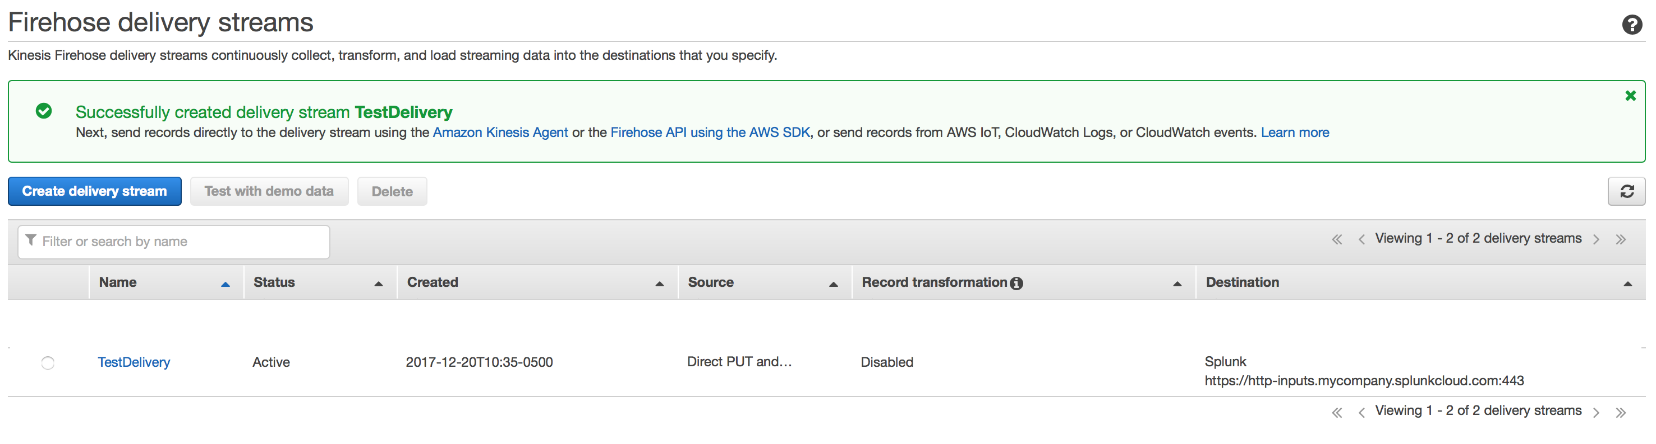
Start Testing Delivery Stream
Wait for the Stream to be “Active,” then click on the Stream to start testing
Click Here

Slide 56
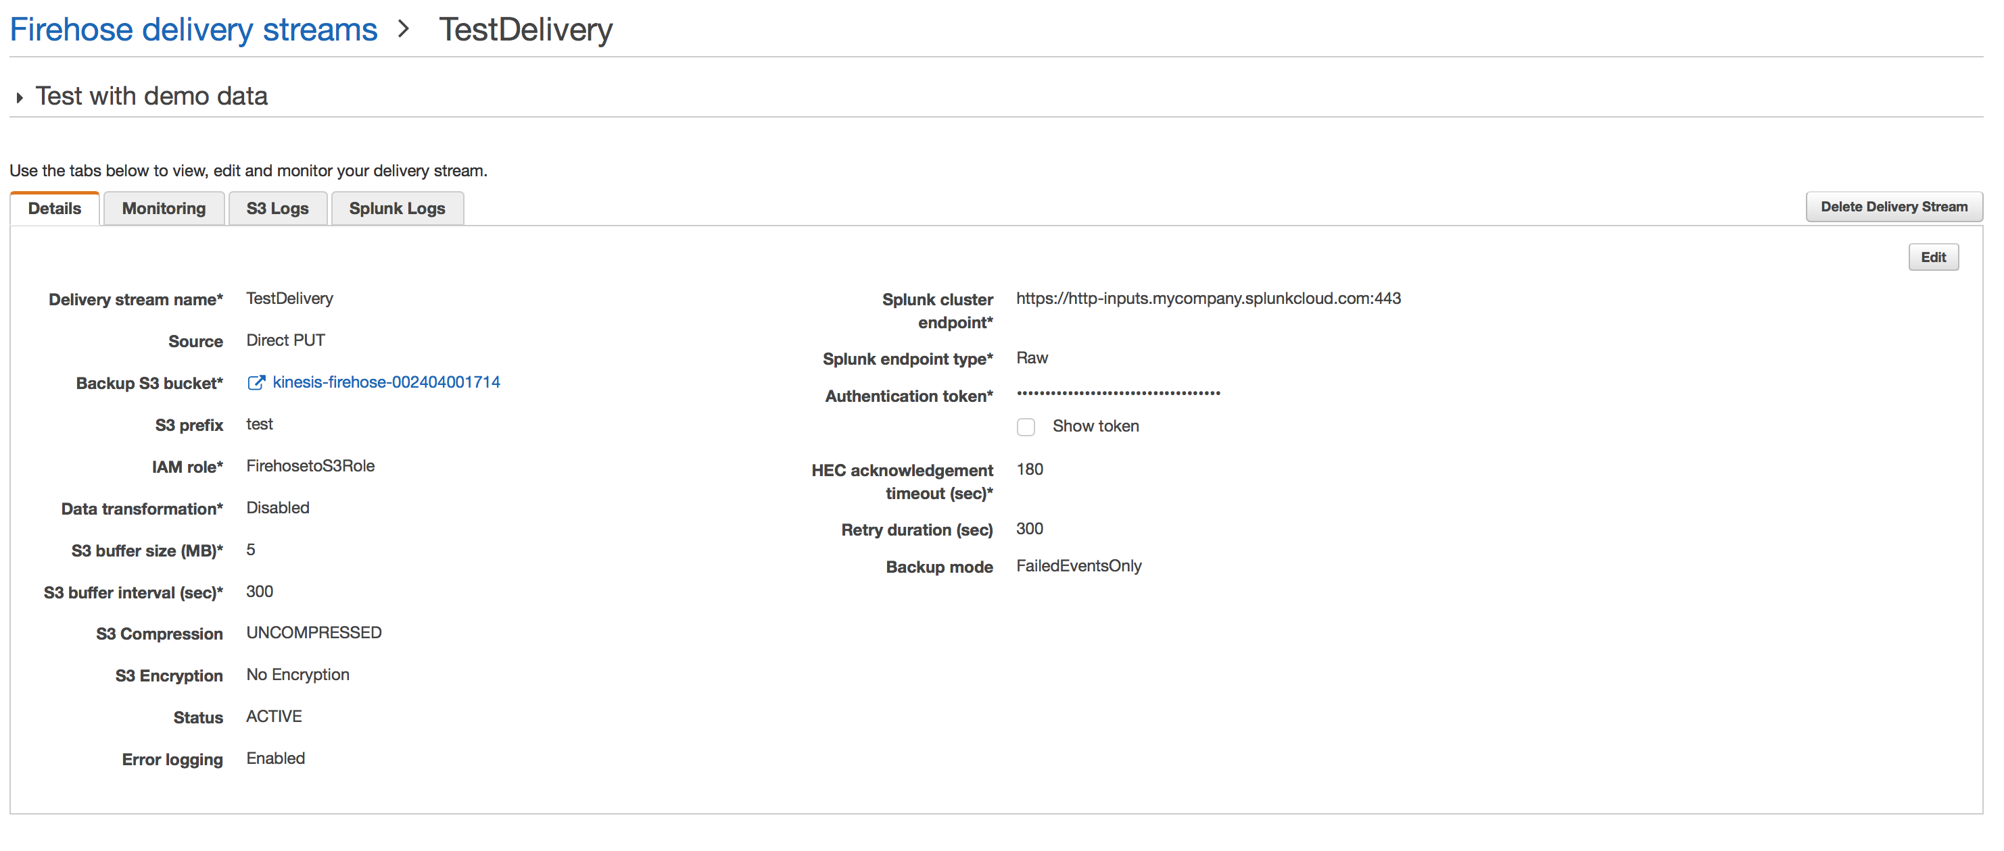
Sending Test Data
Expand the “Test with demo data” area
Click Here

Slide 57
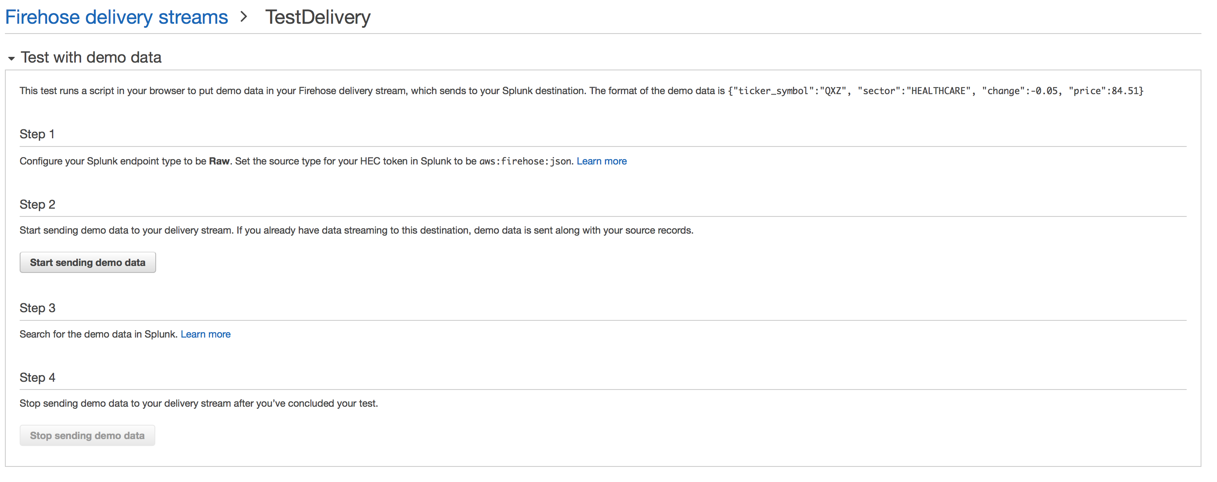
Start Sending Test Data
Once active, search Splunk for demo data
Click Here

Slide 58
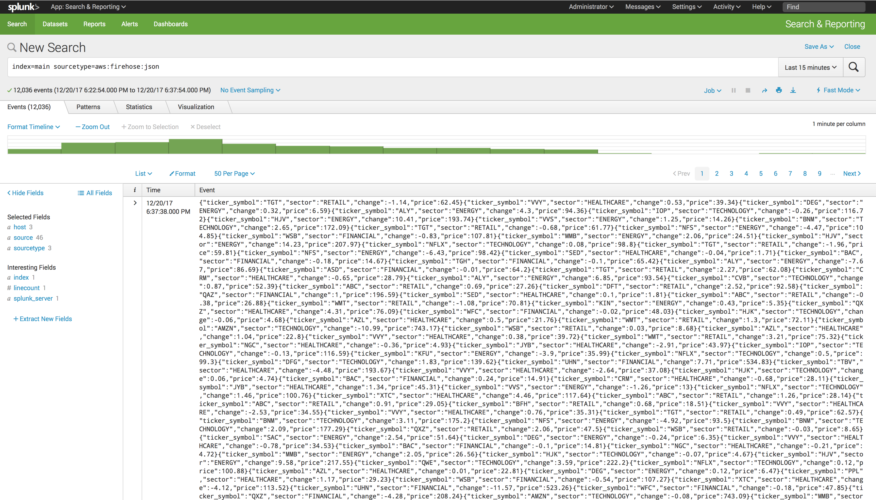
Validate in Splunk
Index=main sourcetype=aws:firehose:json

Slide 59
Test with cURL command
Test using simple cURL command
curl https://http-inputs-firehose-<customer>.splunkcloud.com/services/collector/raw?channel=FE0ECFAD-13D5-401B-847D-77833BD77131 -H "Authorization: Splunk <HEC_Token>" -d 'Hello World’
Where <customer> is the vanity DNS name of your Splunk Cloud Stack and <HEC_Token> is your HEC token. The channel can be left as is and will not affect the result. Finally, you can add a ‘ - v’ at the end of the command to see the verbose output of the cURL command.

Slide 60
Continue to Module 10 :
Collecting Data from AWS Container Services
Getting started with AWS

